Slide 1
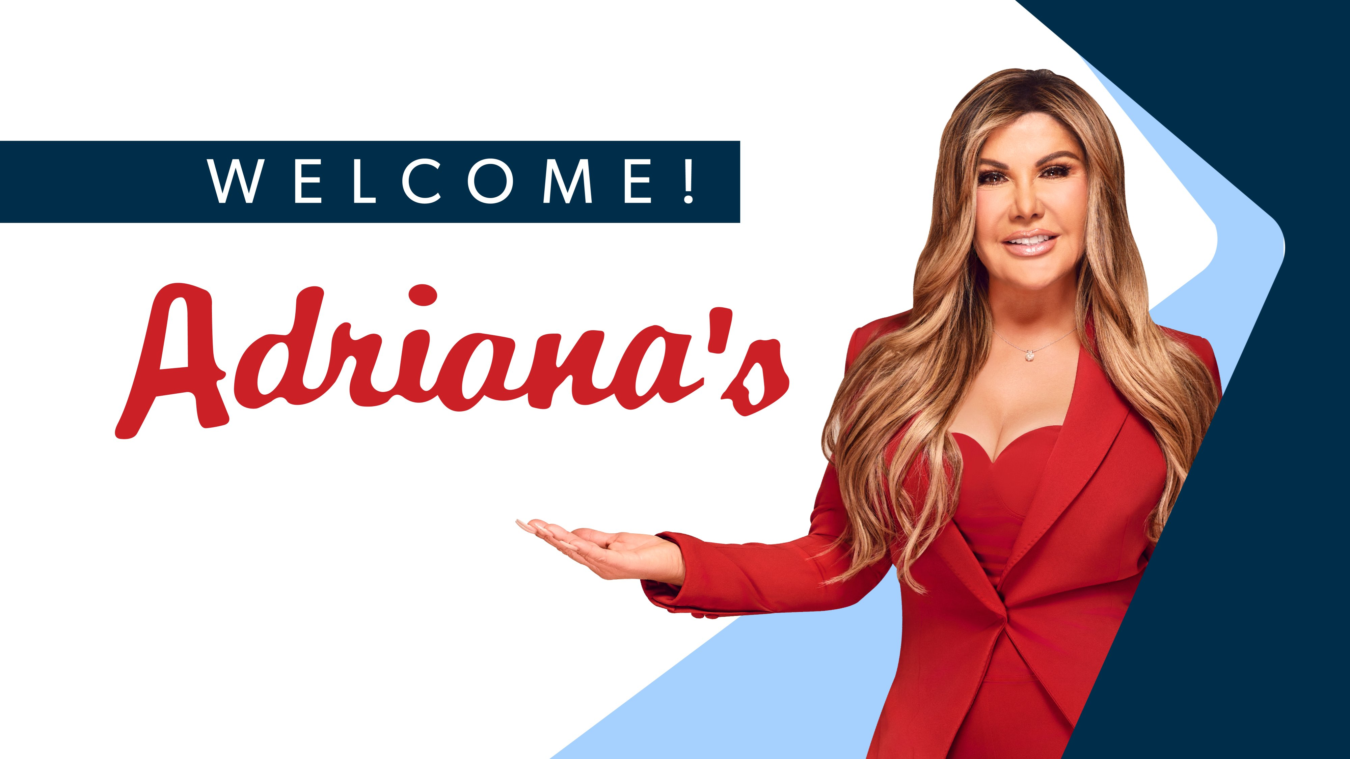
VEHICLE USAGE
ARTISAN vs COMMERCIAL
TRAINING GUIDE
Adriana's Insurance
Understanding Risk, Coverage & the Right Classification
Underwriting Department · Personal Auto Policies

Slide 2
🚗 THE 5 VEHICLE USAGE TYPES — OVERVIEW
Every vehicle must be classified correctly. The wrong usage can result in denied claims, policy cancellations, and compliance violations.
🏠
🏢
🔧
💼
🚛
PLEASURE
COMMUTE
ARTISAN
BUSINESS
COMMERCIAL
Rarely driven
<2,000 mi/yr
To/from work
or school
Tradesman with
tools (no employees)
Professionals
multiple locations
Company fleet
modified/delivery
LOW RISK
LOW RISK
MEDIUM RISK
MEDIUM-HIGH
HIGH RISK
← PERSONAL AUTO POLICY TERRITORY → ← COMMERCIAL POLICY TERRITORY →

Slide 3
SECTION 1
ARTISAN USAGE
Level 2 — Personal Auto Policy · Self-Employed Tradesman
Adriana's Insurance · Underwriting Training

Slide 4
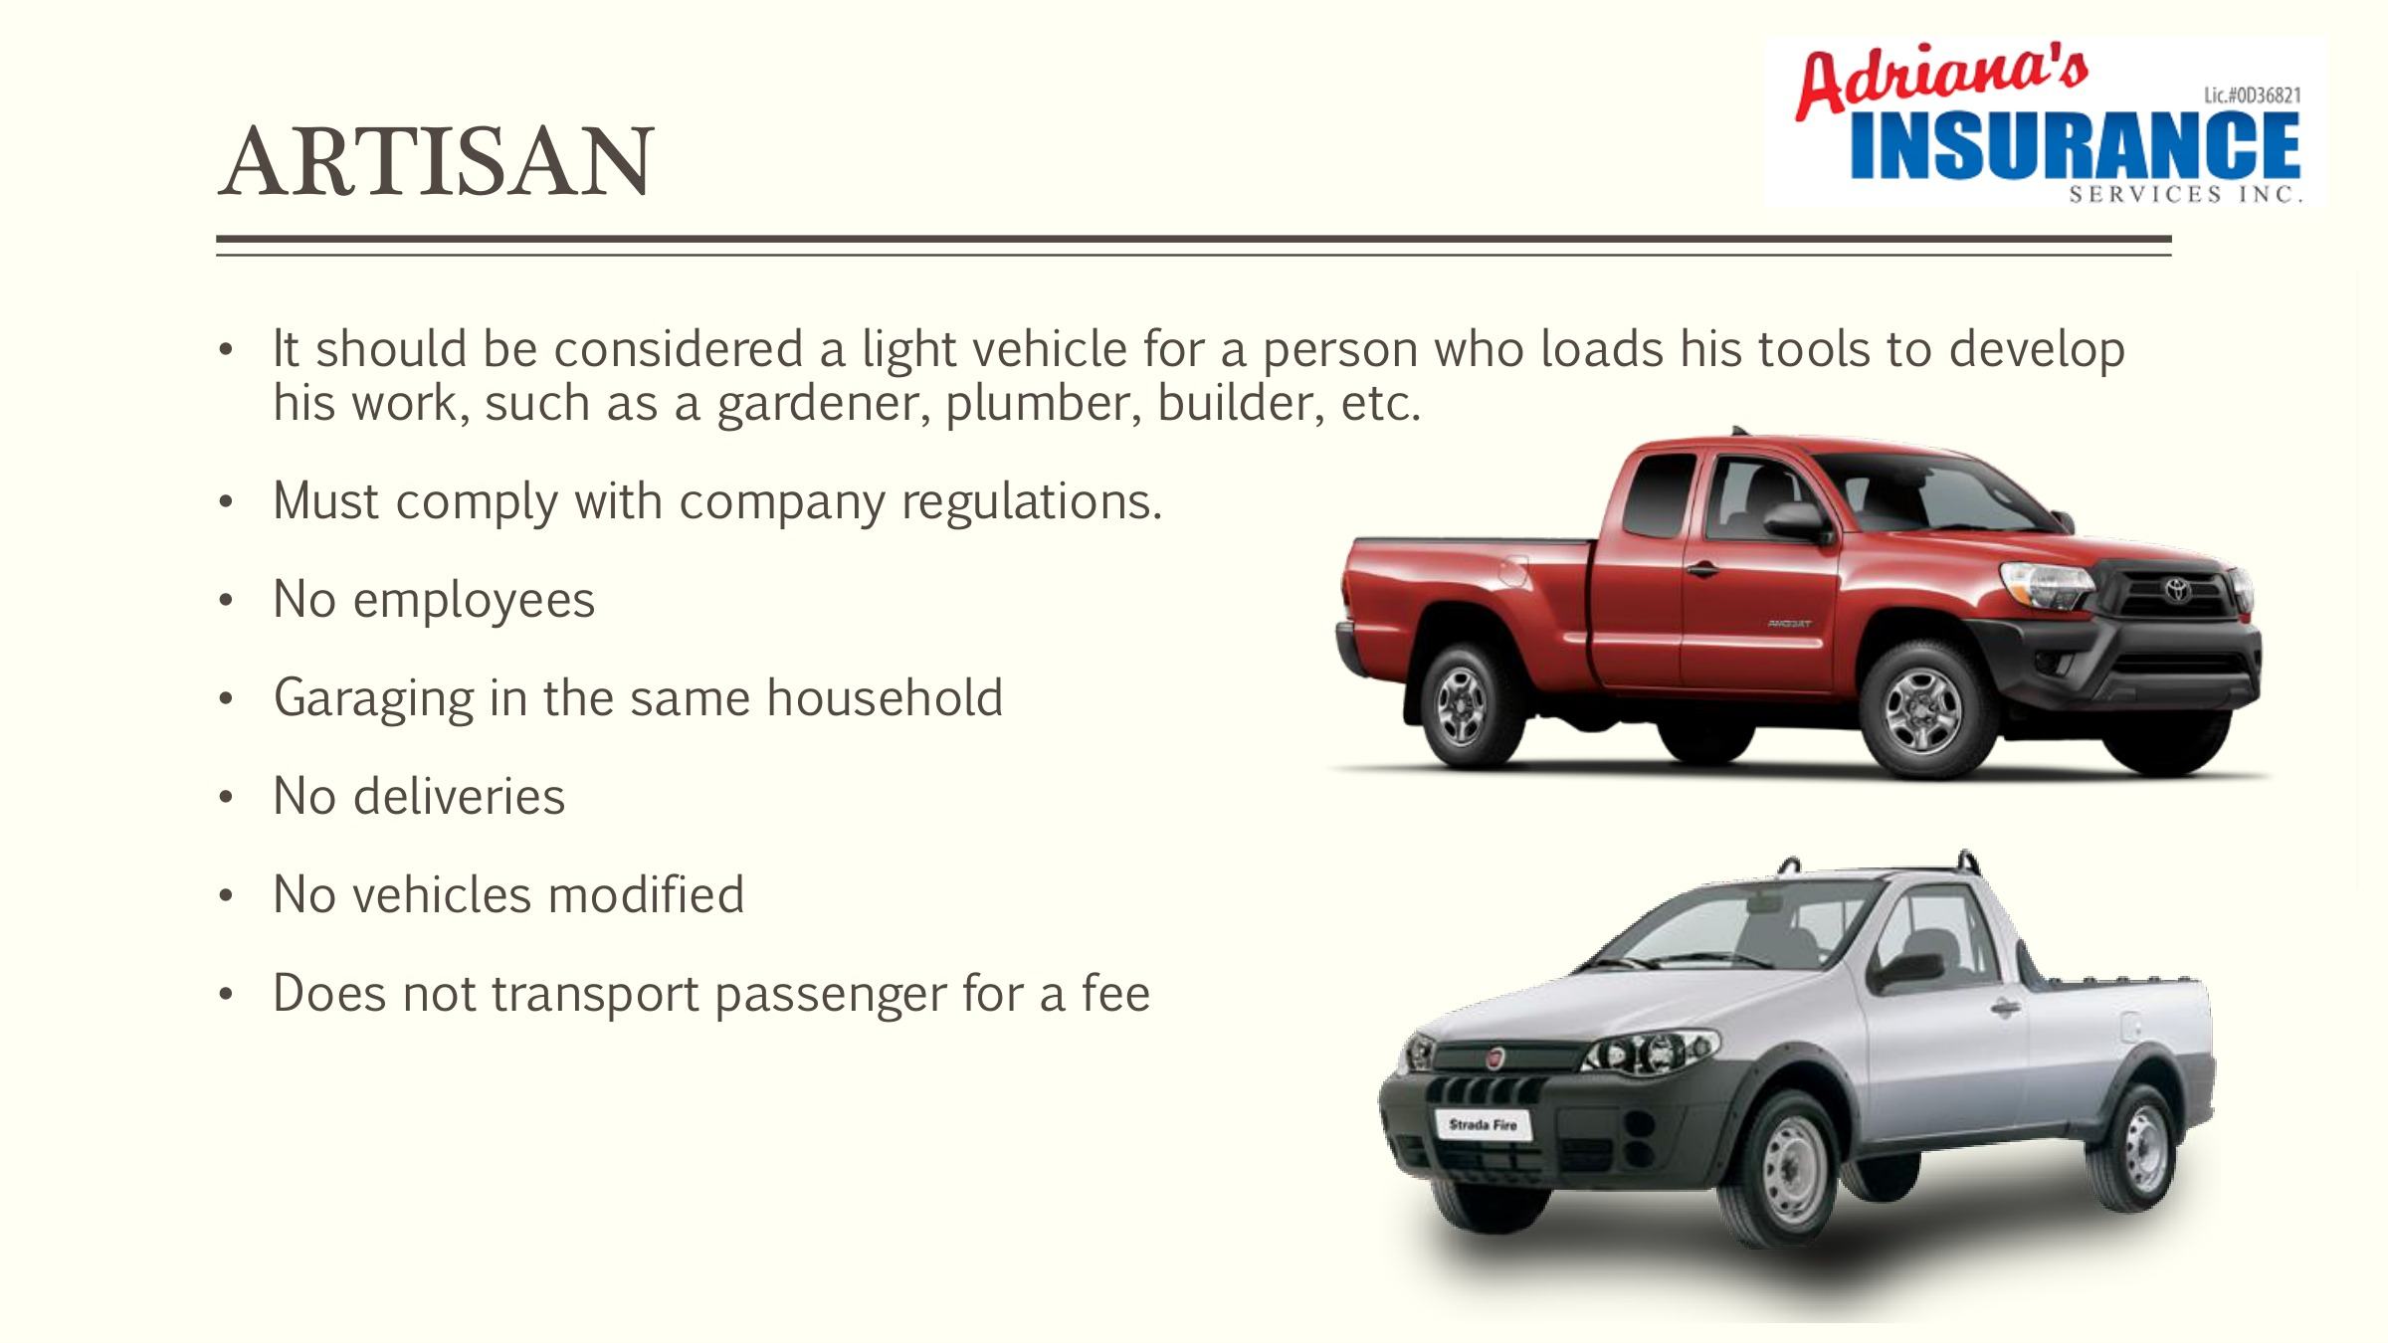
🔧 ARTISAN — WHAT IS IT?
A light vehicle used by a self-employed tradesperson who loads tools to perform their work — gardener, plumber, builder, electrician, painter, etc.
👤 Who qualifies?
Self-employed tradespeople with NO employees. Gardener, plumber, builder, painter, electrician.
🚗 Vehicle type
Pickup trucks or cargo vans only. No modified beds. Max 11,500 GVW.
🔧 Tools allowed
Covers tools carried on the vehicle. Max 500 lbs in equipment. No floating equipment.
📍 Stops per day
Limited daily job site stops (2–5 depending on carrier). Garages at insured household.
🏷 Policy level
Artisan = Level 2 on personal auto policy. Falls under personal auto — NOT commercial.

Slide 5
🔧 ARTISAN — REQUIREMENTS & RESTRICTIONS
✅ WHAT IS ALLOWED
🚫 WHAT IS NOT ALLOWED
✅ Pickup trucks or cargo vans only
🚫 Employees or relatives driving the vehicle
✅ Tools carried on the vehicle (up to 500 lbs)
🚫 Modified beds (stake body, dump, flatbed)
✅ Vehicle legally owned by the individual
🚫 Transport passengers for a fee
✅ One artisan vehicle per policy
🚫 Floating / permanently attached equipment
✅ Commercial and personal use on same vehicle
🚫 Deliveries of any kind
✅ Garages at insured household address
🚫 Vehicle logos or wraps
✅ 2–5 job site stops per day (per carrier)
🚫 More than one artisan vehicle on policy
✅ Racks on truck bed (most carriers allow)
🚫 GVW exceeding 11,500 lbs

Slide 6
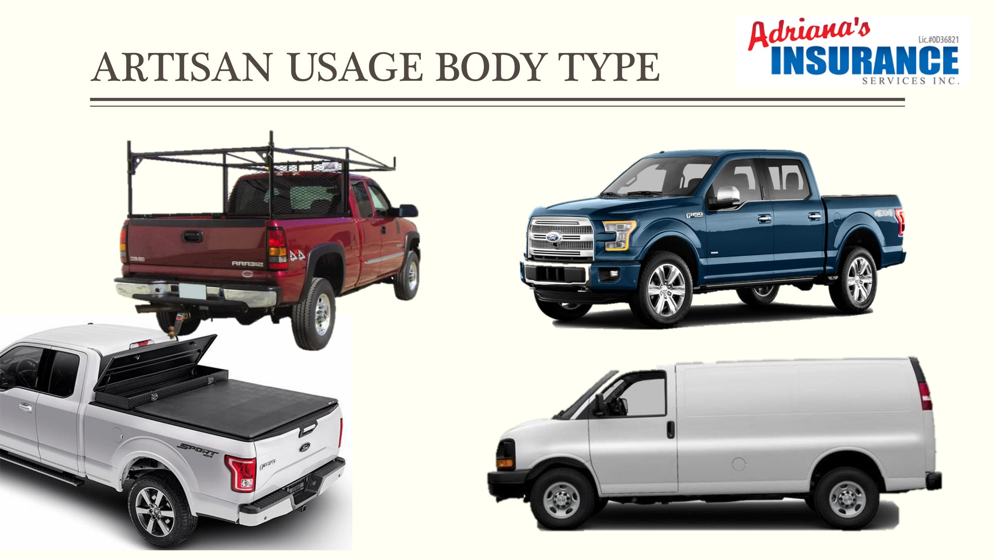
🔧 ARTISAN — ACCEPTED VEHICLE BODY TYPES
ONLY pickup trucks and cargo vans are accepted for Artisan use. No modified beds.

Slide 7
SECTION 2
COMMERCIAL USAGE
Levels 4–6 — Commercial Auto Policy · Company Vehicles
Adriana's Insurance · Underwriting Training

Slide 8
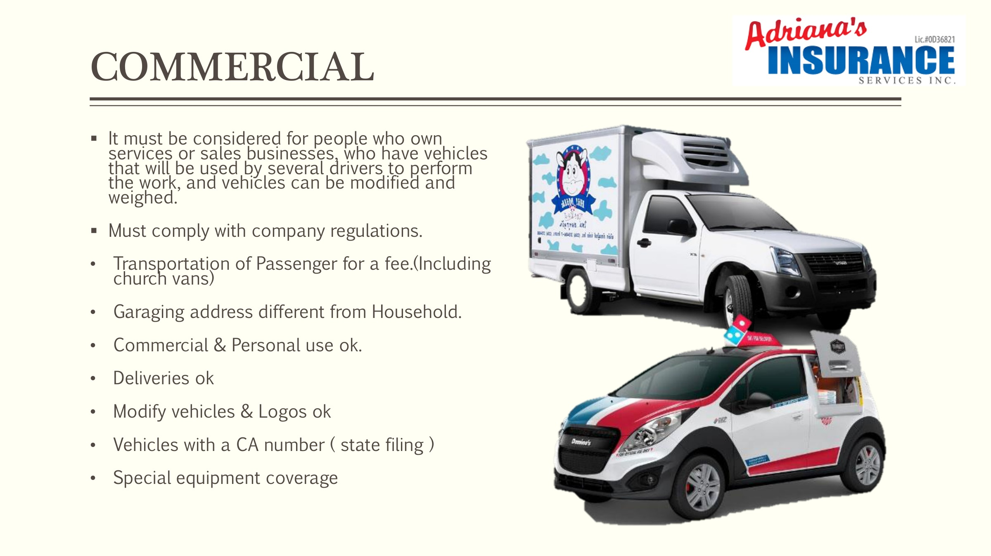
🚛 COMMERCIAL — WHAT IS IT?
Vehicles used by businesses with employees, deliveries, modified vehicles, multiple drivers, or transportation of passengers for a fee.
🏢 Who needs it?
Business owners with company vehicles, employees as drivers, or fleets.
🚛 Vehicle types
Any commercial body type — straight trucks, flatbeds, dump trucks, refrigerated vehicles, vans, trailers and more.
👷 Multiple drivers
Employees can drive as long as they are scheduled/listed drivers on the commercial policy.
📦 Deliveries OK
Deliveries are covered (restrictions apply per carrier). Can transport goods for hire and compensation.
🏷 Policy levels 4–6
Level 4 Basic (self-employed with commercial vehicle), Level 5 (has employees), Level 6 Delux (permits required).

Slide 9
🚛 COMMERCIAL — ADVANTAGES & COVERAGES
Commercial policies cover what personal auto cannot — they are designed for business operations at scale.
🏢 Any ownership entity
👷 Employee drivers
Vehicles can be owned by an LLC, corporation, partnership, or individual — not limited to personal ownership.
Employees can drive vehicles as long as they are scheduled. Add driver endorsement available.
💰 Goods for hire
🔩 Modified vehicles
Can transport goods, merchandise, or passengers for compensation. Deliveries covered (restrictions apply).
Accepts all bed types: stake body, dump truck, flatbed. Logos and vehicle wraps are OK.
⚙ Floating equipment
📋 Weight & coverage
Covers floating equipment for additional fee. Special equipment coverage (Stated Value) available.
Weight limit set by GVW of vehicle. Coverage up to $1,000,000. Federal filings (MCP) accepted.

Slide 10
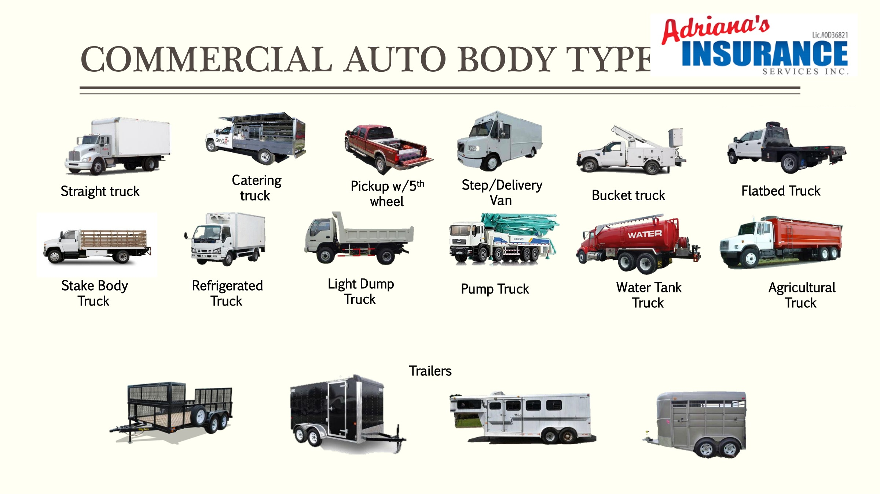
🚛 COMMERCIAL — ACCEPTED VEHICLE BODY TYPES
Commercial policies cover a wide range of body types — far beyond what personal auto allows.

Slide 11
SECTION 3
ARTISAN vs COMMERCIAL
Side-by-Side Risk & Coverage Comparison
Adriana's Insurance · Underwriting Training

Slide 12
⚖️ ARTISAN vs COMMERCIAL — FULL COMPARISON
CATEGORY
🔧 ARTISAN (Level 2)
🚛 COMMERCIAL (Level 4–6)
Policy Type
Personal Auto
Commercial Auto
Who drives
Owner only
Owner + scheduled employees
Employees
❌ None allowed
✅ Allowed (must be listed)
Deliveries
❌ Not covered
✅ Covered (restrictions apply)
Logos / Wraps
❌ Not allowed
✅ Allowed
Vehicle logos
❌ No
✅ Yes
Modified beds
❌ No (pickup/van only)
✅ All types OK
Floating equip
❌ Not covered
✅ For additional fee
Max weight
11,500 GVW
Set by vehicle GVW
Max equipment
500 lbs
Set by commercial limits
Coverage limit
Personal policy limits
Up to $1,000,000
Garaging
Must be insured household
Can be different address
Transport pax
❌ No
✅ Yes (including church vans)

Slide 13
⚠️ KNOWING WHEN TO ESCALATE TO COMMERCIAL
If ANY of the following are true, the vehicle CANNOT be written as Artisan — it requires a Commercial Auto policy.
👷 The insured HAS EMPLOYEES who use the vehicle
🚚 The vehicle is used for DELIVERIES
Even occasional use by employees = Commercial
Any delivery of goods, food, or packages = Commercial
💰 The vehicle TRANSPORTS PASSENGERS FOR A FEE
🔧 The vehicle has MODIFIED BEDS (stake, dump, flatbed)
Including church vans, rideshare, shuttles
Artisan accepts pickup/van ONLY
🏢 The vehicle GARAGES AT A DIFFERENT ADDRESS than the insured
⚙ GVW EXCEEDS 11,500 lbs
Artisan must garage at insured household
Artisan is light vehicle use only
🏷 Vehicle has LOGOS, WRAPS, or COMMERCIAL MARKINGS
📦 More than the carrier-allowed STOPS PER DAY
Personal/Artisan requires clean, unmarked vehicles
Verify per carrier: Aspire/Myco/Nations = max 5/day

Slide 14
📋 CARRIER GUIDELINES — ARTISAN (Level 2)
Not all carriers accept Artisan use. Always verify the carrier grid before writing. Last updated: 01/02/2026.
CARRIER
ARTISAN
VEH/POLICY
STOPS/DAY
RACKS
LOGOS
QUESTIONNAIRE
MIN COVERAGE
Anchor
❌
—
—
—
—
—
—
Aspire
✅
2
5
✅
✅
✅
30/60/15
Blue Fire
✅
1
3
✅
✅
✅
30/60/15
Bristol West
✅
1
3
✅
✅
✅
100/300/50
Bridger
✅
1
3
✅
❌
❌
30/60/15
Carnegie
❌
—
—
—
—
—
—
Kemper-Infinity
BUS USE
1
3
❌
❌
✅
30/60/15
Mapfre
❌
—
—
—
—
—
—
Myco
✅
1
5
✅
✅
❌
30/60/15
Nations
✅
1
5
✅
✅
❌
30/60/15
National General
✅
1
2
✅
❌
❌
30/60/15
Pronto
✅
1
5
❌
❌
❌
30/60/15
Reliant
✅
1
3
✅
✅
❌
30/60/15
Safeway
❌
—
—
—
—
—
—
Suncoast
❌
—
—
—
—
—
—

Slide 15
📊 USAGE LEVEL SYSTEM — PERSONAL TO COMMERCIAL
The 6-level system determines when a personal auto policy applies vs. when a commercial auto policy is required.
← PERSONAL
COMMERCIAL →
Commercial Delux
Commercial Expanded
Requires permits; hired/non-owned endorsements
Commercial Basic
Has employees who drive company vehicles
6
Business Use
Self-employed, commercial body type vehicle
5
Artisan
Professional taking clients to sites (personal vehicle)
4
Personal Auto
Self-employed, no employees, 2–5 stops/day
3
Commutes home/work only
2
1
PERSONAL POLICY
PERSONAL POLICY
PERSONAL POLICY
COMMERCIAL POLICY
COMMERCIAL POLICY
COMMERCIAL POLICY

Slide 16
❓ THE 101 QUESTIONS — CLASSIFYING VEHICLE USAGE
Always ask these questions before assigning usage. The wrong classification = claim denial.
1
How is the vehicle primarily used?
6
Do you transport passengers for pay (Uber, church van, etc.)?
→ Determines base usage type (pleasure, commute, artisan, business, commercial).
→ Transportation for fee = Commercial only.
2
Do you use the vehicle for work? What kind of work?
7
Does the vehicle have logos, wraps, or business markings?
→ Triggers artisan or business classification if work-related.
→ Logos = not eligible for personal or artisan use.
3
Do you carry any tools or equipment in the vehicle?
8
Where does the vehicle garage at night?
→ If tools are carried to job sites → Artisan. Check weight (max 500 lbs).
→ Must match insured address for artisan. Different address = may need commercial.
4
Do you have any employees who drive this vehicle?
9
How many stops or job sites do you visit per day?
→ Even one employee = cannot be Artisan. Escalate to Commercial Level 4+.
→ Artisan is limited to 2–5 stops/day depending on carrier.
5
Do you make any deliveries with this vehicle?
10
Has the vehicle been modified (bed, equipment, weight)?
→ Deliveries are excluded from personal and artisan policies.
→ Modified bed or GVW over 11,500 lbs = cannot be artisan.

Slide 17
REMEMBER
"The wrong usage classification doesn't just affect the premium —
it determines whether a claim gets PAID or DENIED."
🔧 Artisan = personal auto, no employees, pickup/van only, max 500 lbs tools
🚛 Commercial = employees, deliveries, modified vehicles, any body type
🚫 Employees + any vehicle = CANNOT be Artisan → escalate to Commercial
⚠ Always ask the 101 questions before assigning vehicle usage
📋 Verify carrier grid — not every carrier accepts Artisan use

