Slide 1

INTERNAL FORMS
Agent Training
Guide
Adriana's Insurance Services, Inc.
Understanding & Completing Our Required Documents

Slide 2
FORMS OVERVIEW
What We'll Cover Today
01
Pending Information Sheet
02
Broker Fee Disclosure
Track missing client documents
Disclose total fees charged
03
Uber & Lyft Exclusion
04
Household Member Form
Exclude rideshare/delivery use
Disclose all household members
05
Agent Advice
06
Promissory Note
Policy recommendations & coverage
When a balance is owed (if applicable)

Slide 3
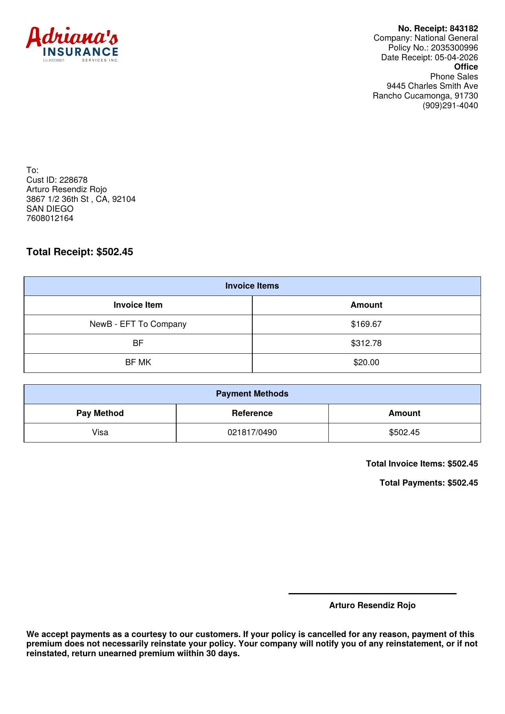
$
Understanding the Receipt — New Business Line Items
BF — Broker Fee
e.g. $312.78
The core service fee charged by the agent for placing and managing the client's insurance policy. This amount is set by the broker (not the insurance company) and must be disclosed on the Broker Fee Disclosure form.
BF MK — Marketing Fee
e.g. $20.00
An additional fee charged by the agency for marketing and administrative services. BF + BF MK together equal the total broker fee amount shown on the Broker Fee Disclosure form (±$10 tolerance).
NewB – EFT to Company
e.g. $163.26 / $169.67
The down payment sent electronically (EFT) to the insurance carrier to initiate the client's new policy application. This is the insurer's portion — it goes directly to National General (or the carrier) to bind coverage.
Balances (when present)
e.g. $75.00
Any unpaid amount remaining after the client's payment. When a balance appears on the receipt, a Promissory Note must be completed for that exact dollar amount before the client leaves.
💡 Key rule: BF + BF MK = total broker fee on the disclosure form | NewB-EFT goes to the carrier | Balance ≠ $0 → always complete a Promissory Note

Slide 4
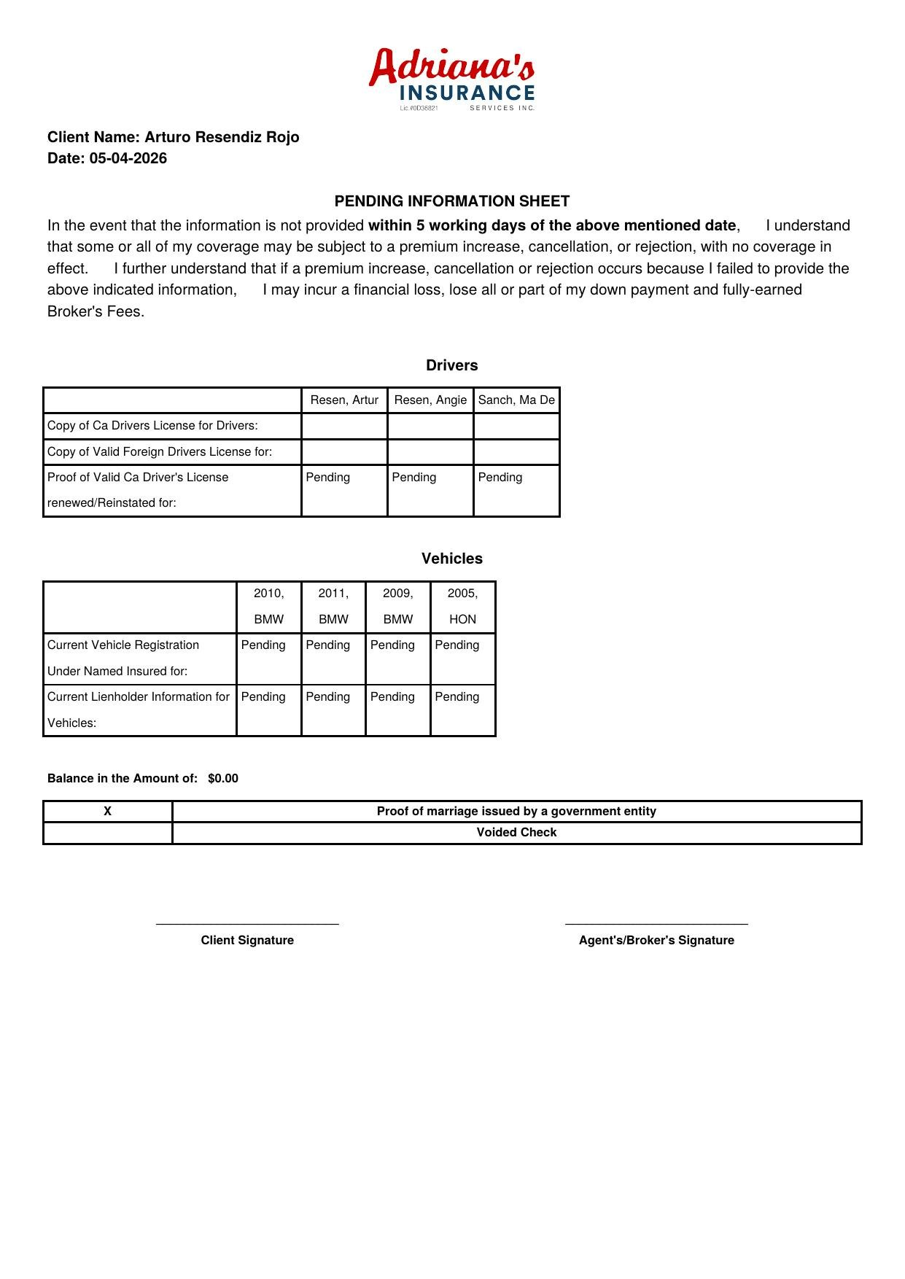
01
Pending Information Sheet
▶ FORM PREVIEW
Track any missing client information that must be submitted
✓
Identifies documents or information still needed from the client
✓
Client has 5 business days from the policy date to provide missing info
✓
Failure to provide info may lead to premium increase, cancellation, or rejection
✓
Covers missing driver docs (CA License, foreign license) and vehicle docs (registration, lienholder)
✓
Also used to request items like proof of marriage or a voided check
✓
Any outstanding balance owed is noted at the bottom of this form
✍ SIGNATURES REQUIRED: Client signature + Agent/Broker signature

Slide 5
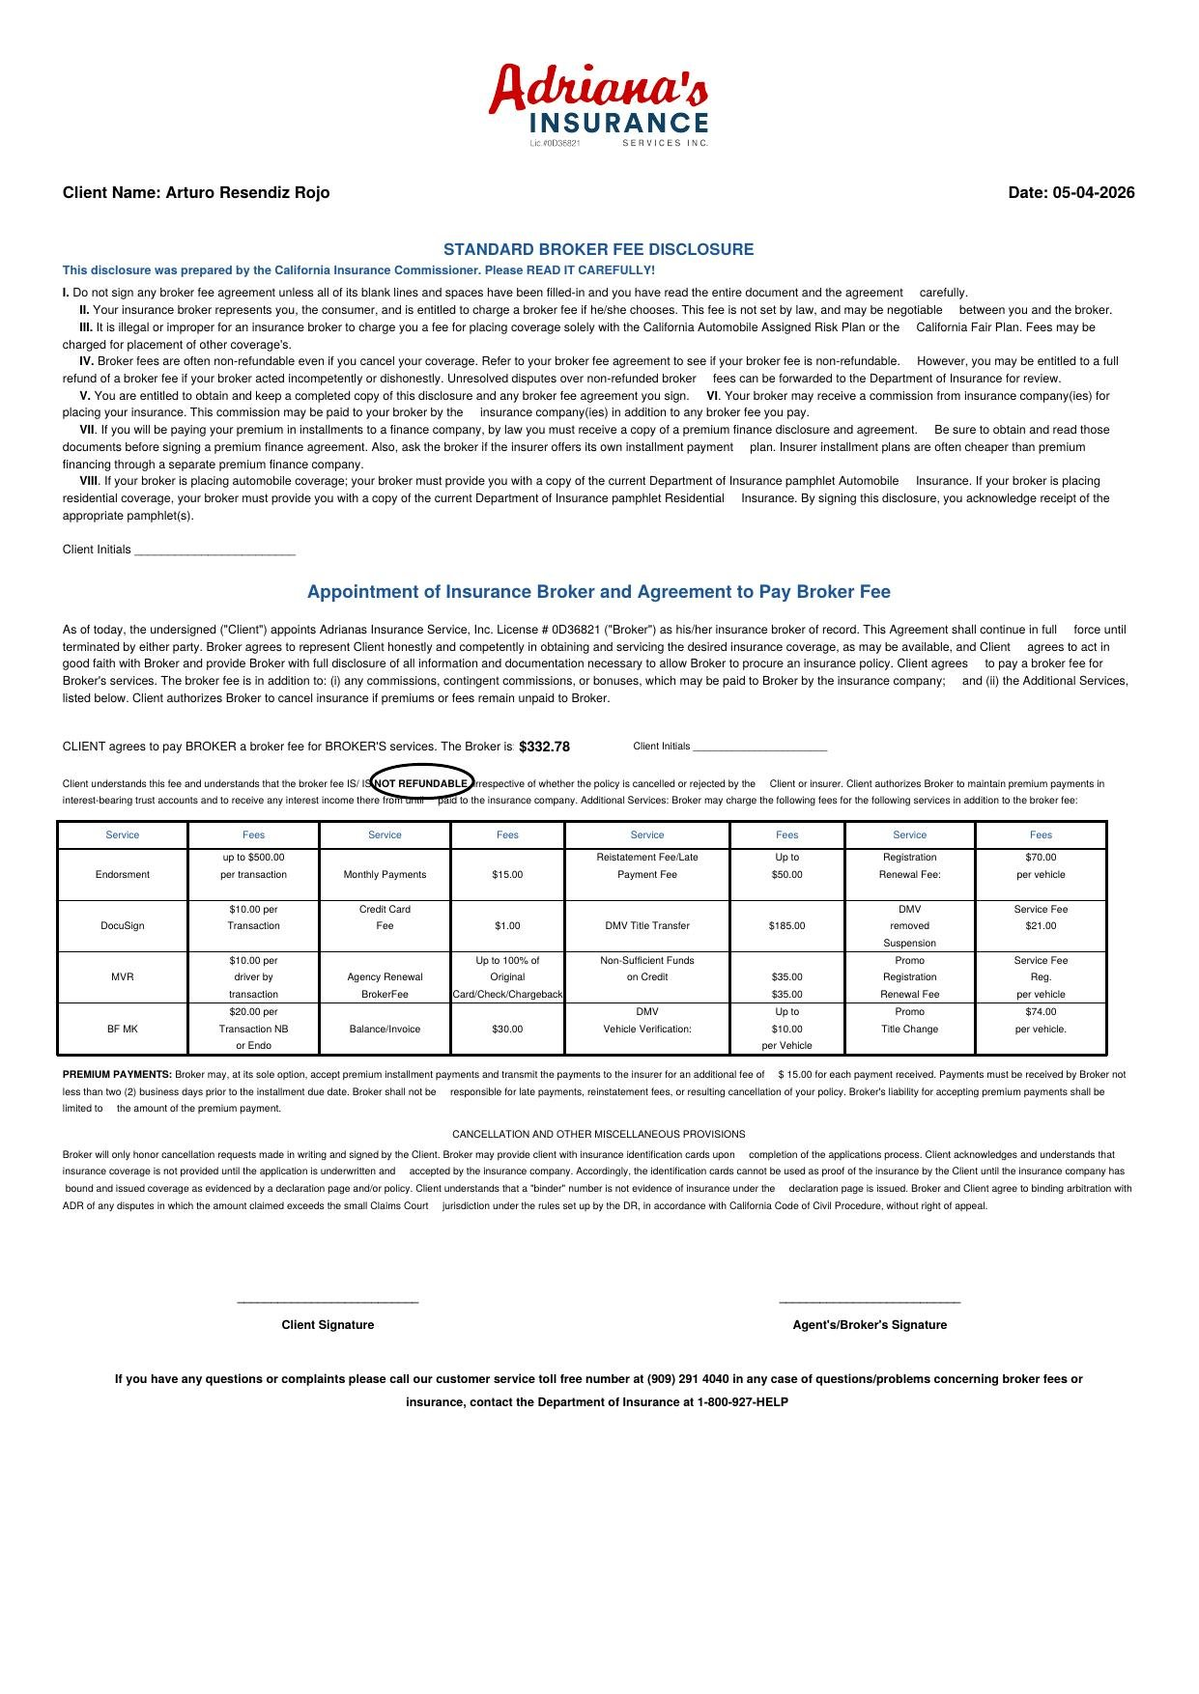
02
Broker Fee Disclosure
▶ FORM PREVIEW
The most critical form — discloses total broker fee charged
✓
States the total amount charged by the agent: BF + BF MK + Donation ($10 tolerance allowed)
✓
Per CA law, broker fees are not set by law and may be negotiable
✓
Illegal to charge a fee for placements solely with CA Assigned Risk Plan or CA Fair Plan
✓
Broker fees are typically NON-REFUNDABLE even if policy is cancelled — must be stated clearly
✓
Client may get full refund only if broker acted incompetently or dishonestly
✓
Disputes over non-refunded fees can be forwarded to CA Dept. of Insurance for review
✍ SIGNATURES REQUIRED: Client initials (2 places) + Client signature + Agent/Broker signature

Slide 6
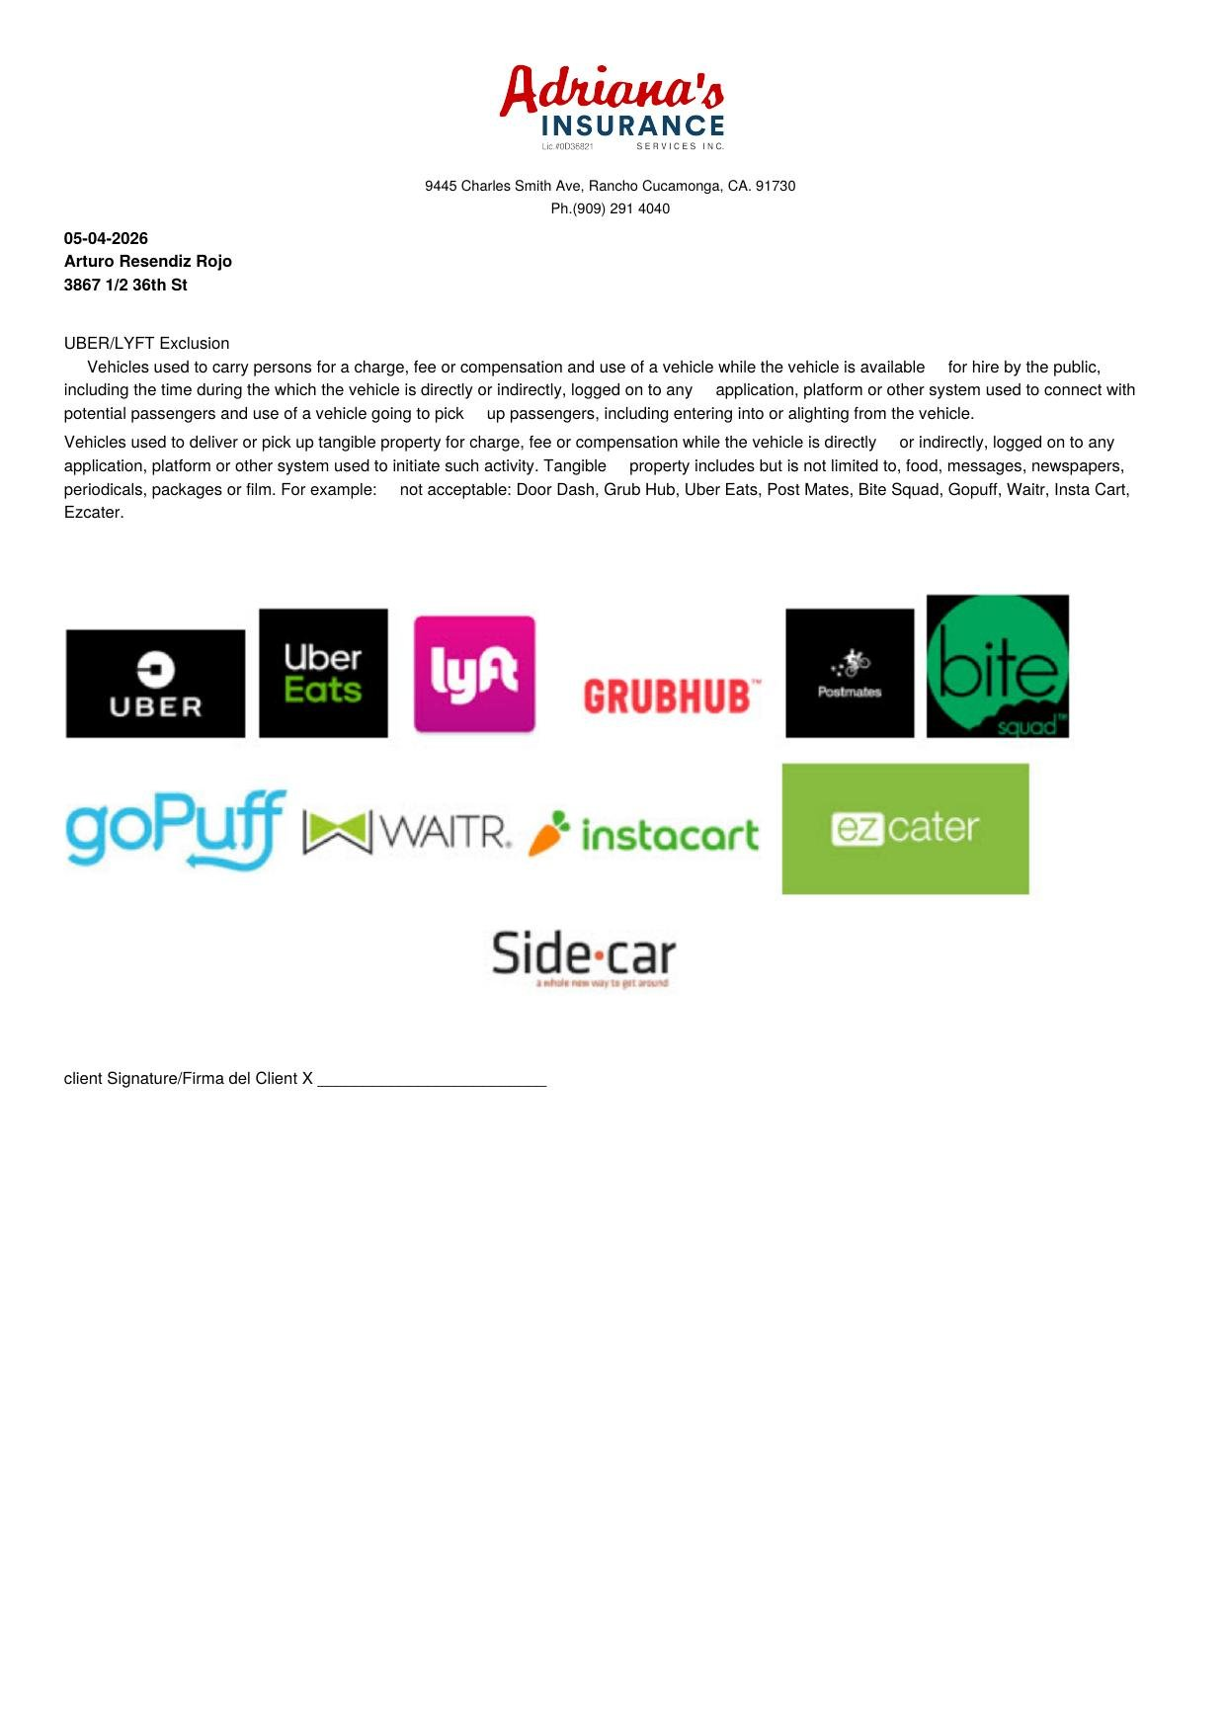
03
Uber & Lyft Exclusion
▶ FORM PREVIEW
Client confirms vehicle will NOT be used for rideshare or delivery
✓
Policy does NOT cover vehicles used to carry passengers for a fee or compensation
✓
Excludes any time vehicle is logged onto a rideshare/delivery app — even waiting for a ride
✓
Also excludes delivery of tangible property for compensation (food, packages, etc.)
✓
Excluded platforms: Uber, Lyft, DoorDash, GrubHub, Instacart, Postmates, Gopuff, Waitr, Ezcater
✓
Using vehicle for these purposes = claim DENIED under this policy
✓
Client signs to acknowledge and accept this exclusion before coverage begins
✍ SIGNATURES REQUIRED: Client signature only

Slide 7
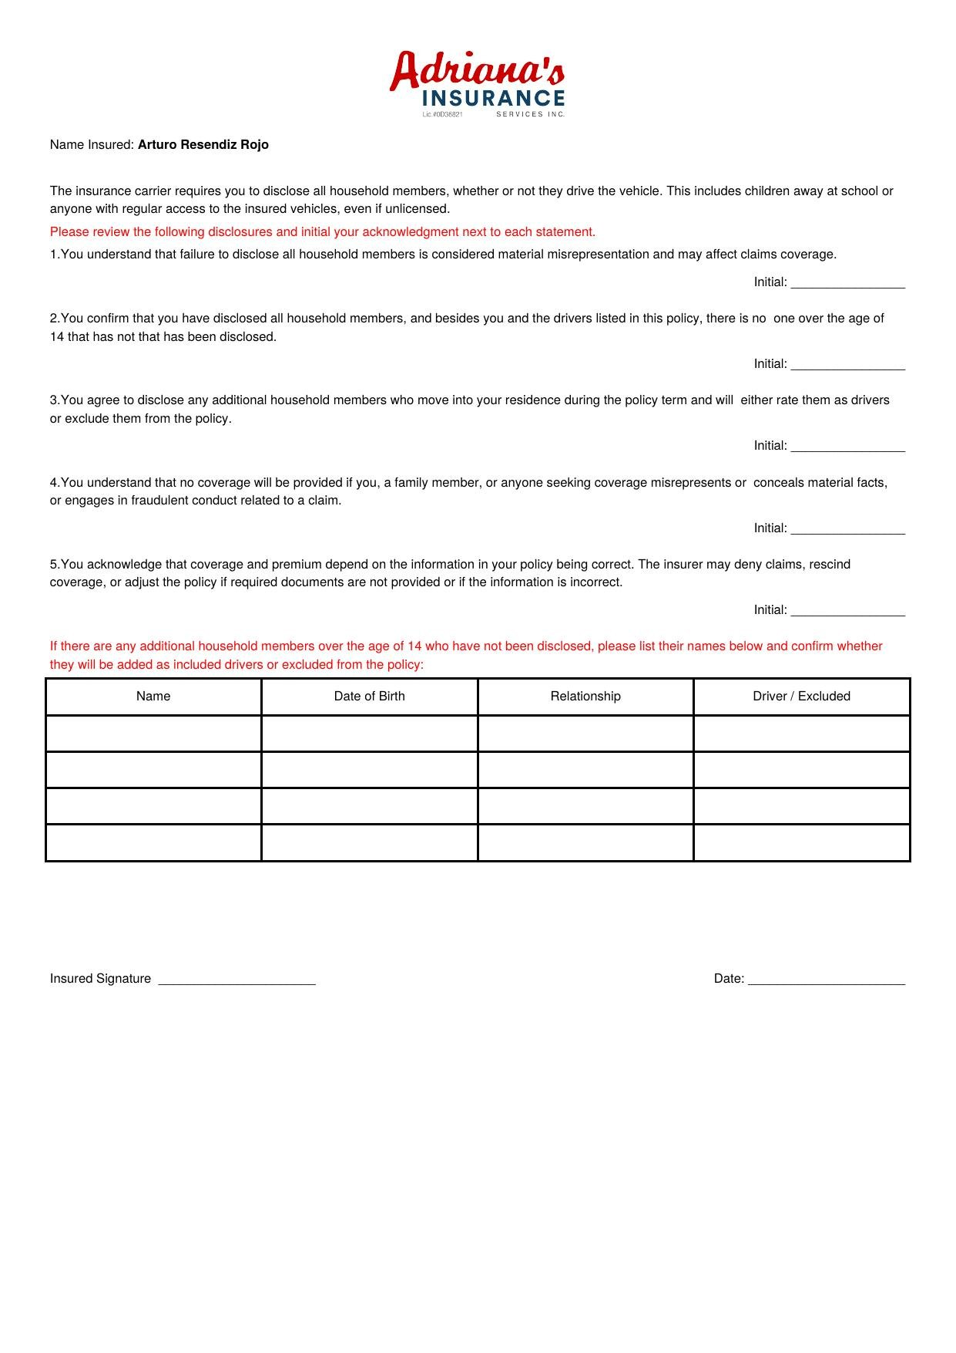
04
Household Member Disclosure
▶ FORM PREVIEW
All household members must be disclosed to the insurance carrier
✓
Carrier requires ALL household members disclosed — whether or not they drive
✓
Includes children away at school and anyone with regular access to insured vehicles
✓
Failure to disclose = material misrepresentation, may affect claims coverage
✓
Client confirms no one over age 14 in the household has been left undisclosed
✓
Client agrees to notify broker of any new household members during the policy term
✓
Additional members can be listed as included drivers or excluded from the policy
✍ SIGNATURES REQUIRED: Client initials on each of 5 statements + Client signature

Slide 8
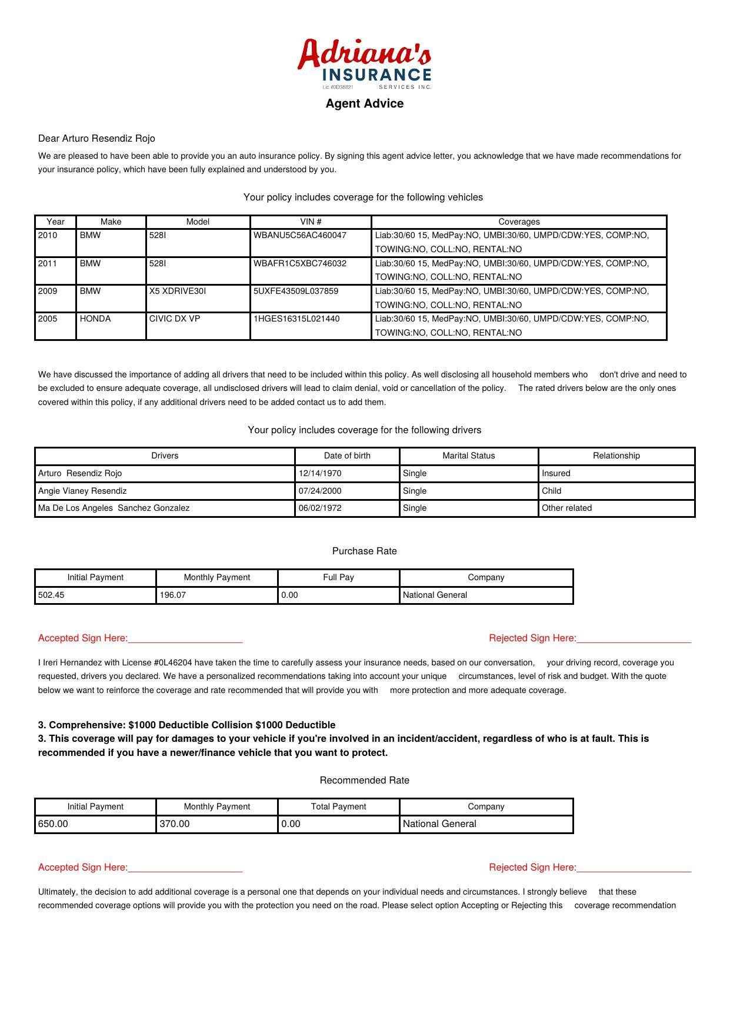
05
Agent Advice
▶ FORM PREVIEW
Formal recommendation — documents vehicles, drivers, and coverage choices
✓
Lists every vehicle insured: Year, Make, Model, VIN, and full coverage details
✓
Lists all rated drivers: name, date of birth, marital status, relationship to insured
✓
Agent makes a formal coverage recommendation (e.g., adding Comp & Collision)
✓
Client signs ACCEPTING their current chosen coverage on the Purchase Rate line
✓
Client signs REJECTING the agent's recommendation if declining upgraded coverage
✓
Both client and agent sign at the bottom confirming the conversation and full agreement
✍ SIGNATURES REQUIRED: Client (Accept) + Client (Reject recommendation) + Agent & Client final signatures

Slide 9
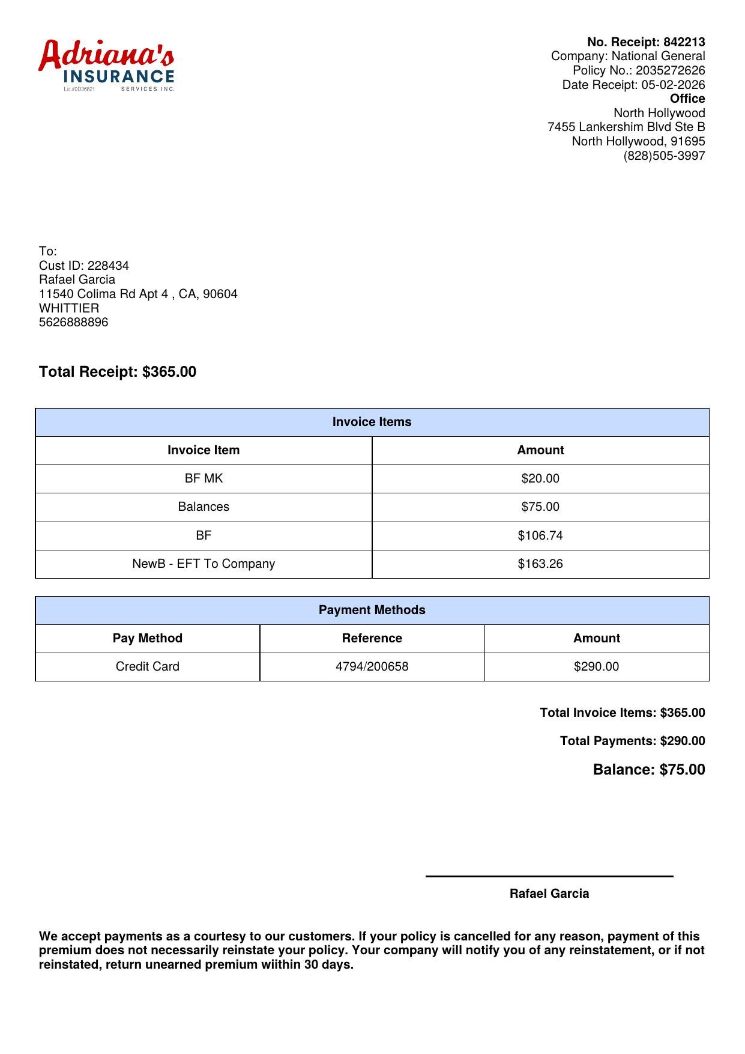
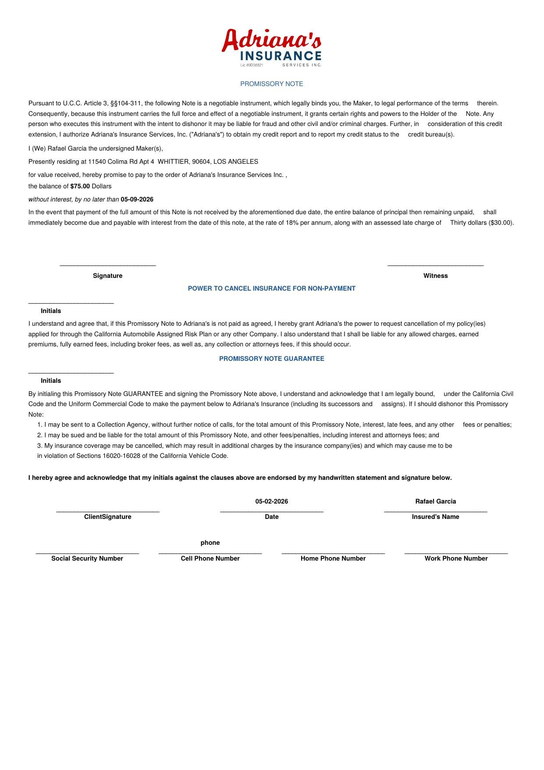
06
Promissory Note
▶ FORM + RECEIPT EXAMPLES
Client's written promise to pay an outstanding balance — only when applicable
Receipt showing Balance
Promissory Note Form
✓
ONLY used when the client has a remaining balance owed for Adriana's services
✓
Specifies the exact dollar amount owed and the agreed payment due date
→
✓
Legally binding under U.C.C. Article 3 — grants Adriana's power to cancel policy if unpaid
✓
Late payment triggers 18% annual interest + a $30.00 late charge
✓
Client must initial: (1) Power to Cancel for Non-Payment & (2) Promissory Note Guarantee
⚠ Shows Balance: $75.00
Balance → Promissory Note
✓
Do NOT use this form when the client's balance is $0.00
How it connects: The receipt shows the unpaid Balance. That amount becomes the dollar figure on the Promissory Note, which the client signs as a legal promise to pay.
✍ SIGNATURES REQUIRED: Client signature + 2 sets of initials + Witness signature

Slide 10
QUICK REFERENCE SUMMARY
At-a-Glance: All 6 Internal Forms
# | Form Name | Who Signs | When Used
01 | Pending Information Sheet | Client + Agent | Always – when info is missing
02 | Broker Fee Disclosure | Client (initials) + Agent | Always – discloses total fee
03 | Uber & Lyft Exclusion | Client only | Always – excludes rideshare/delivery
04 | Household Member Form | Client (initials x5) | Always – disclose all members
05 | Agent Advice | Client (x2) + Agent | Always – documents coverage choices
06 | Promissory Note | Client + 2 initials + Witness | Only if balance is owed
Questions? Contact your supervisor or call: (909) 291-4040

