Slide 1

Safeway Insurance Company
SafewayXChange Point-of-Sale Process

Slide 2
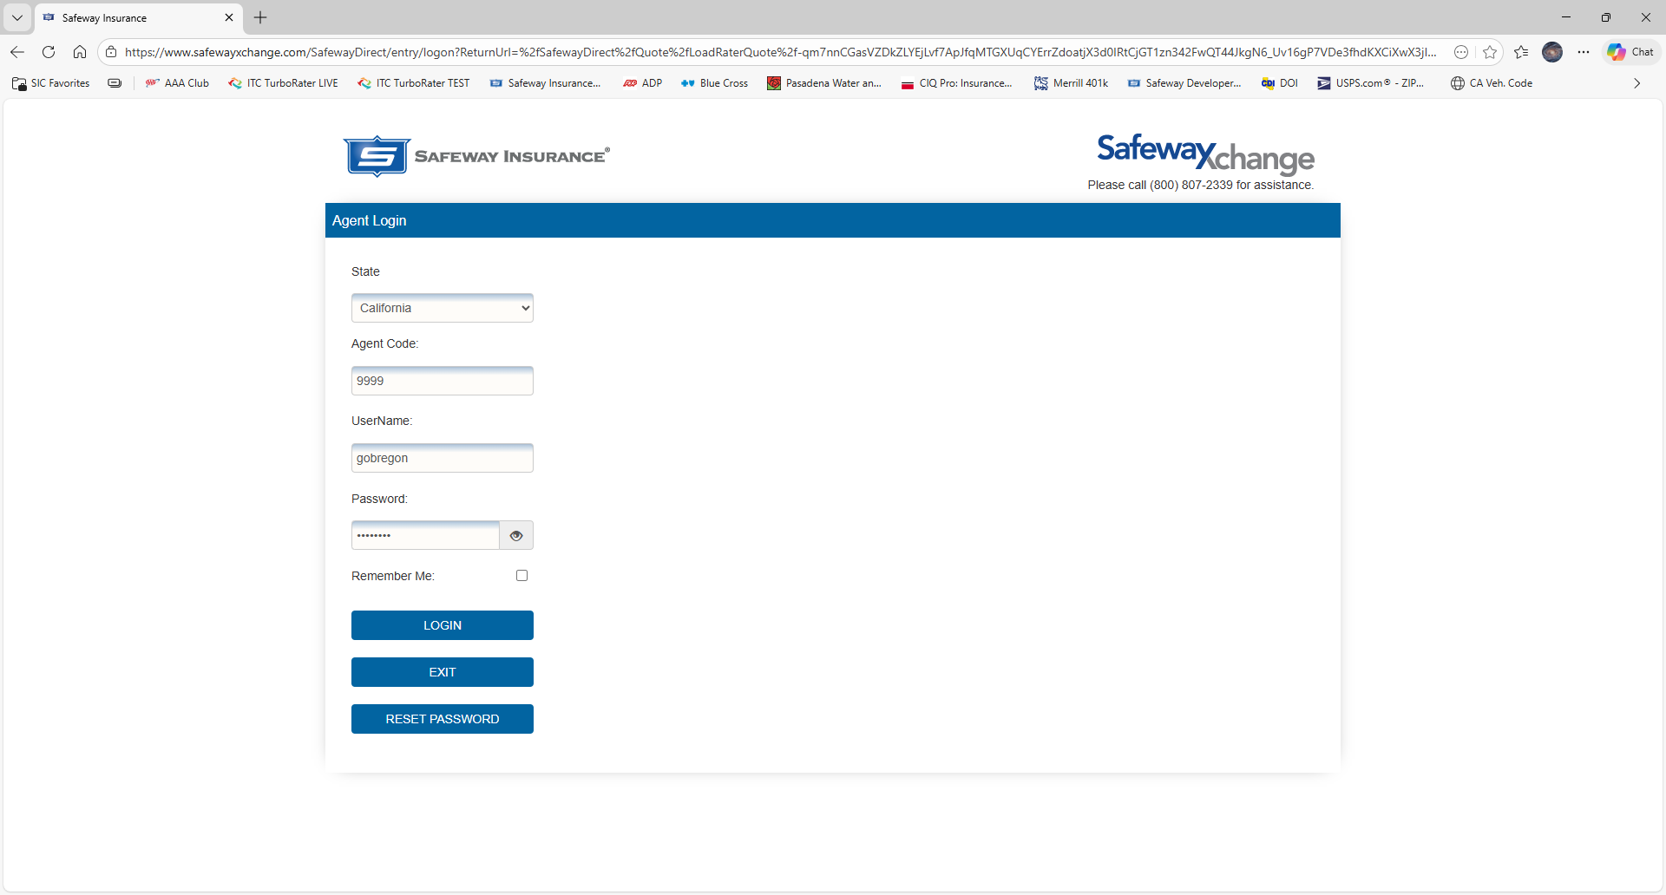
Upon bridging over from your comparative rater, you will be prompted to enter your login credentials.

Slide 3
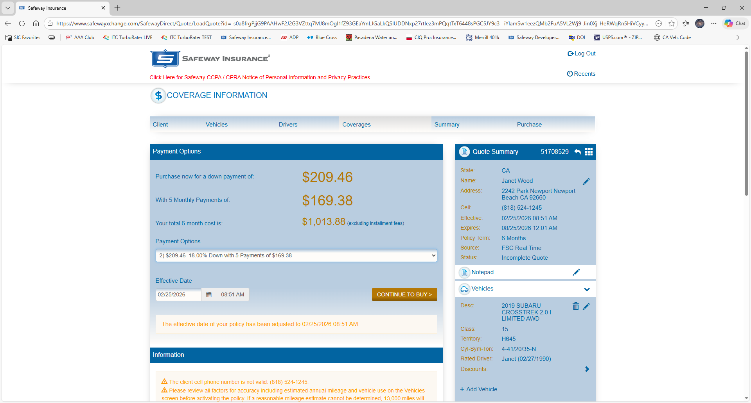
Once in, you are taken directly to the Coverages tab.
If no further changes are required, for instance, adding or deleting coverages, click on Continue to Buy.

Slide 4
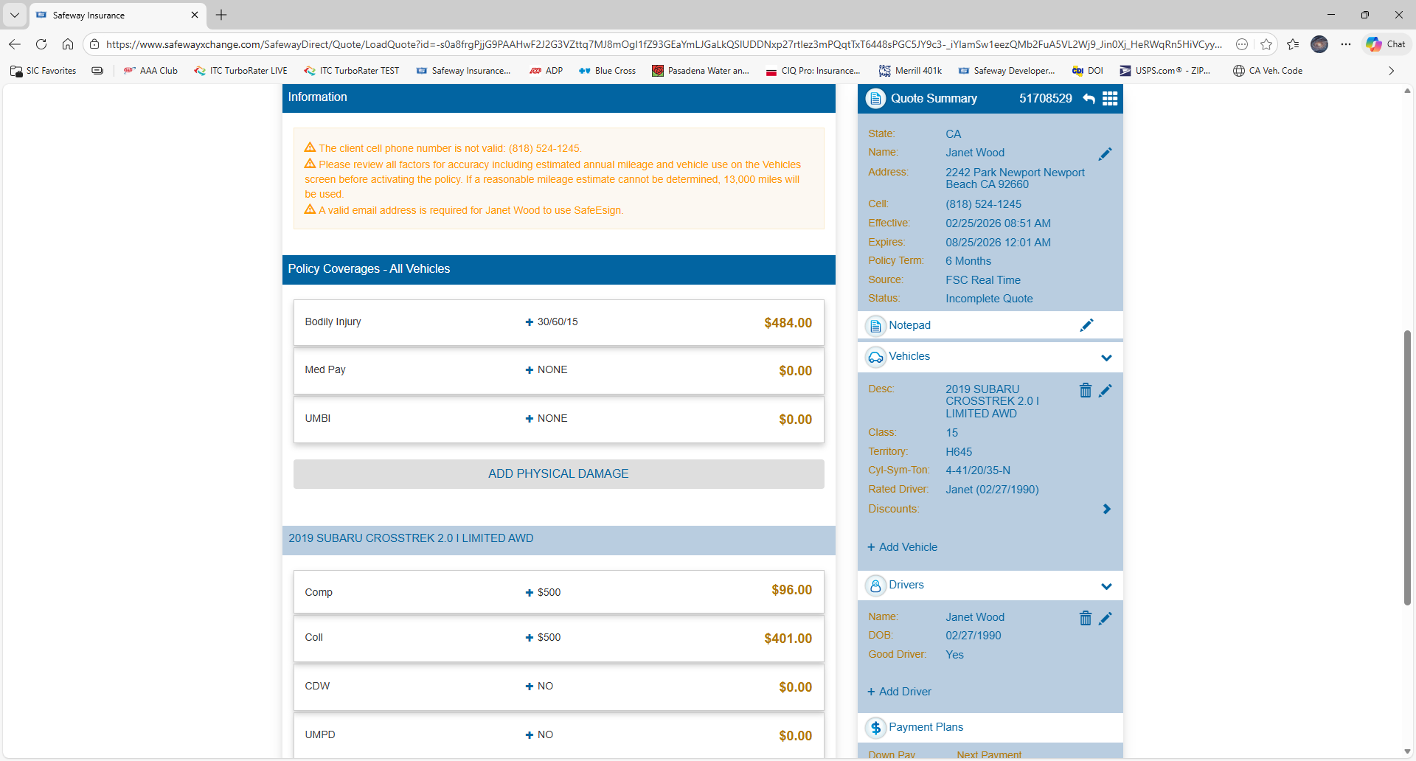
As you scroll down the page, you will see some information messages. No message will stop the selling process unless it is in Red.
Coverages can be added or deleted at any time.

Slide 5
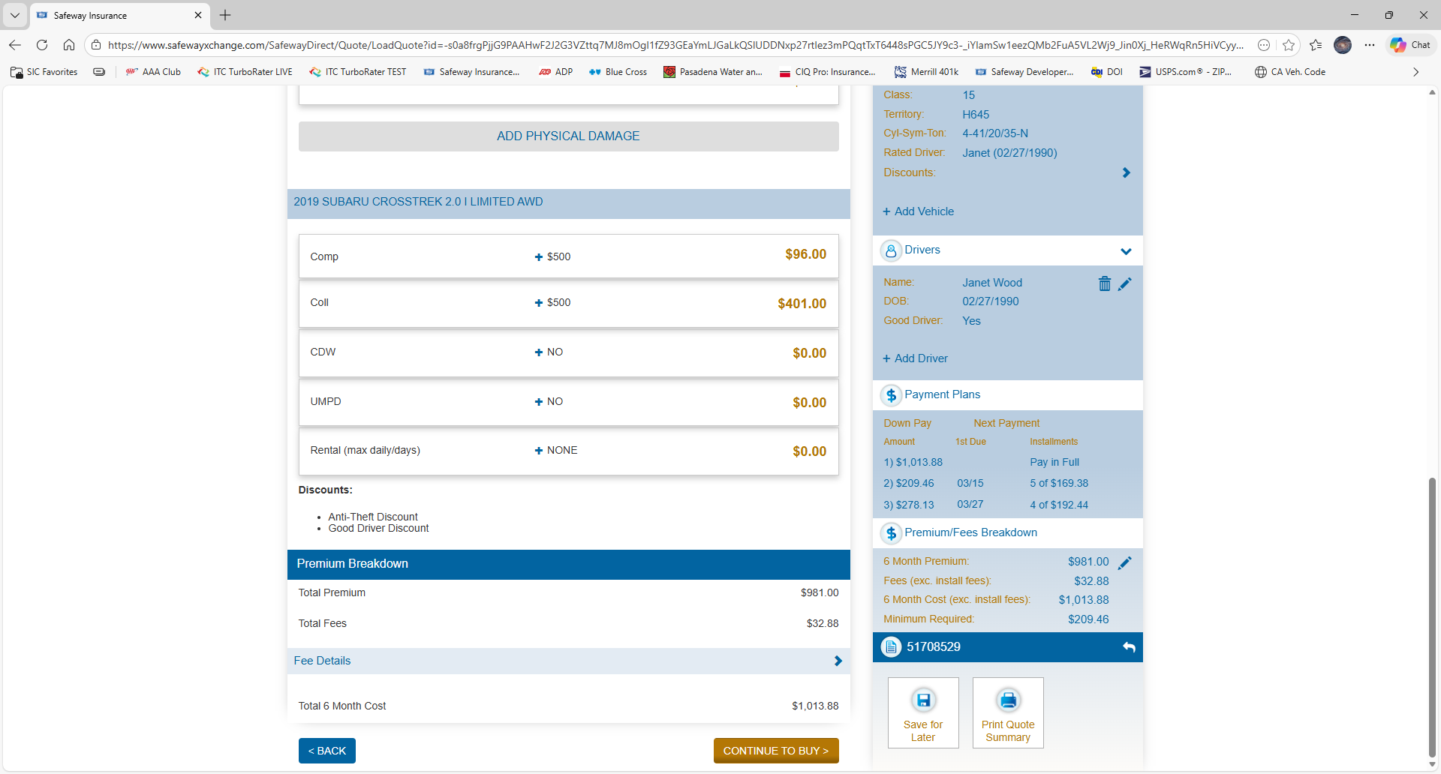
To the left, you will see exactly when the first payment will be do. Discuss this with the insured as the 5-payment plan will have the first payment due in 18 days.
At the bottom of the page you will see the total premium breakdown and another Continue to Buy button.

Slide 6
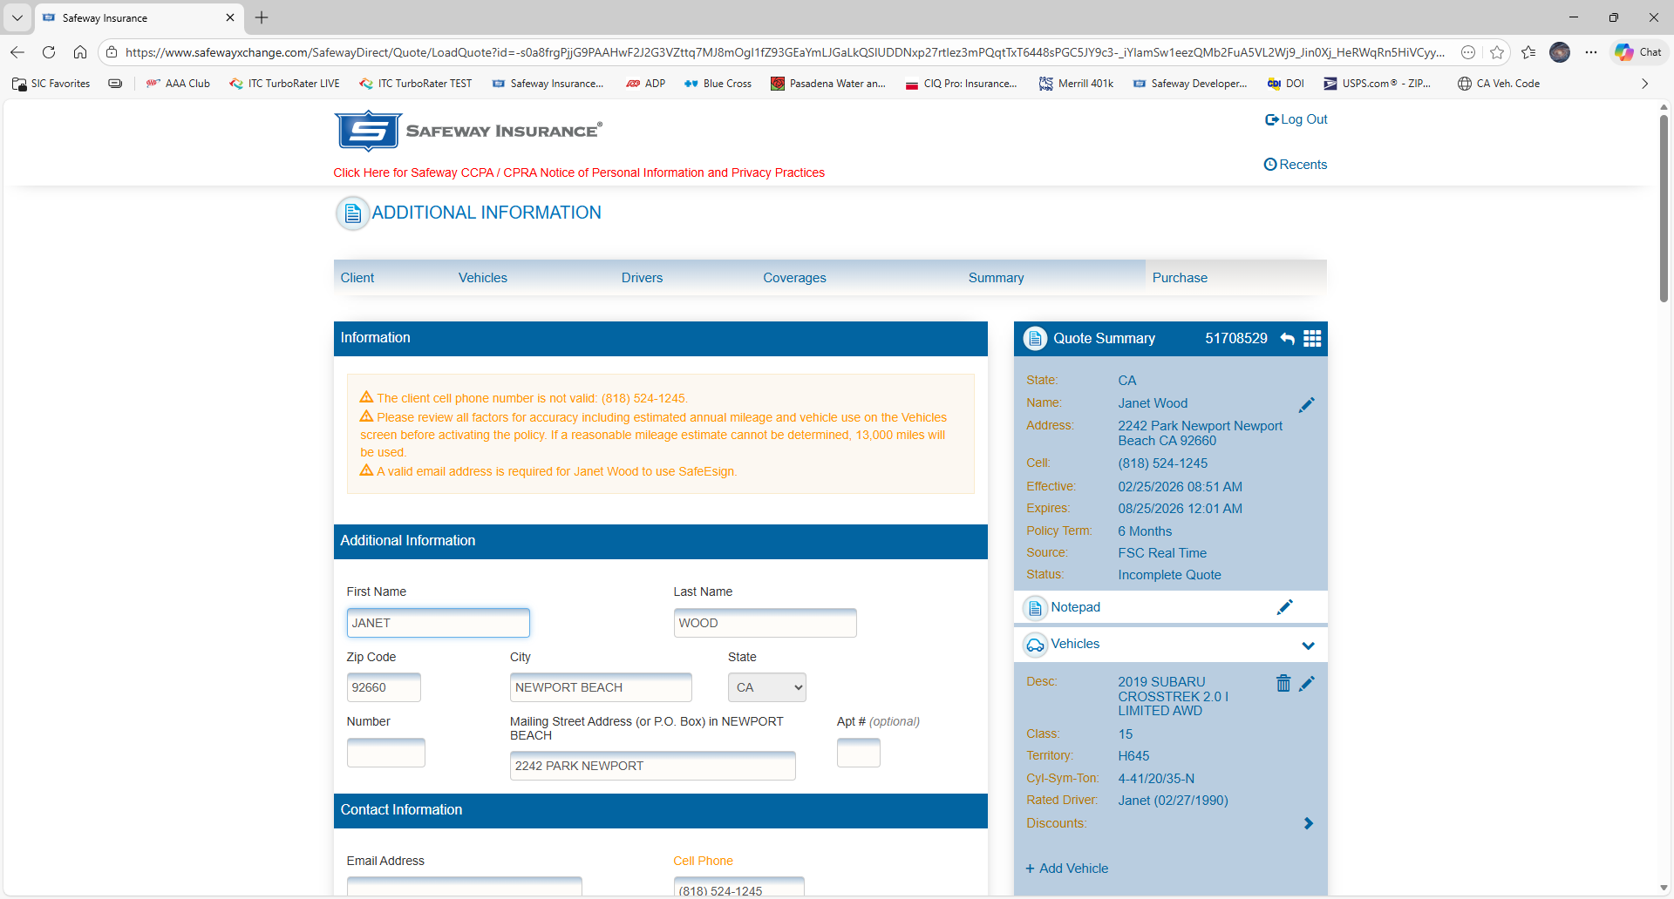
On the purchase tab, you will scroll down and fill in any missing information.

Slide 7
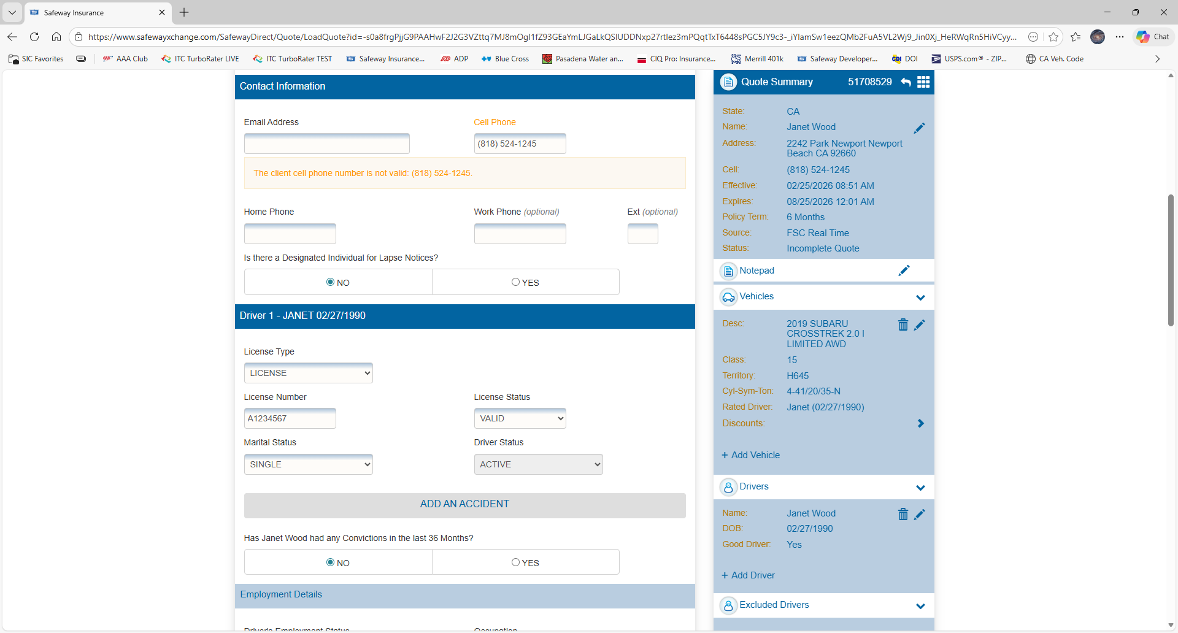
When a complete quote is entered on your comparative rater, all information will be carried over and entered for you.
It will save you the time of entering in more information here.

Slide 8
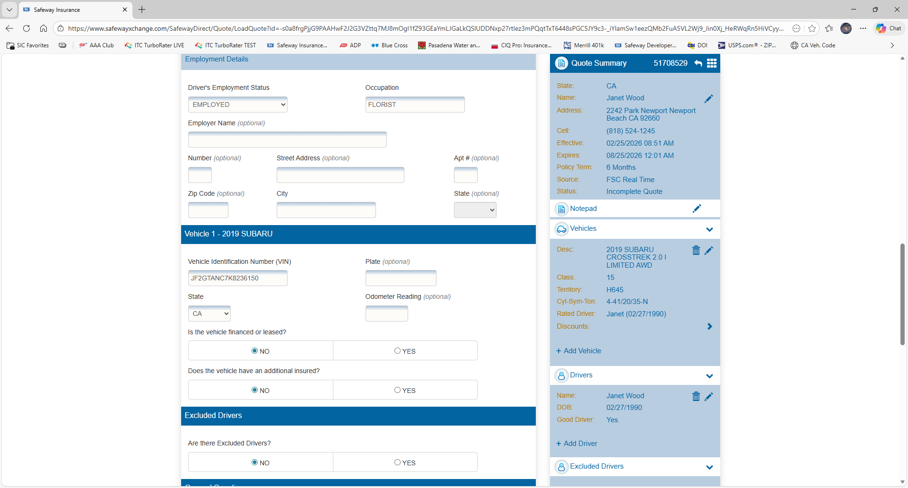
Occupation is a required field.
A few vehicle questions here.
Excluded drivers can be added here.

Slide 9
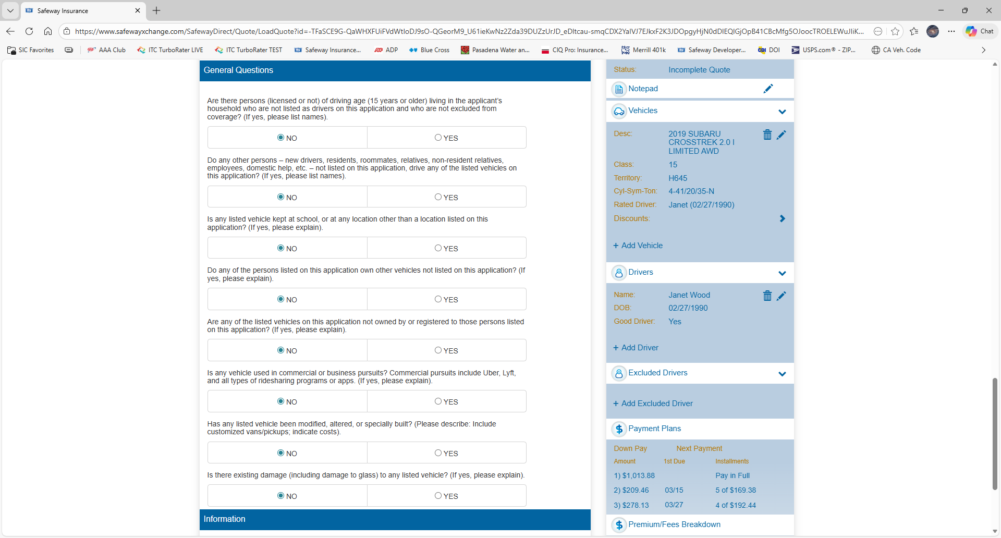
8 underwriting questions that will generally always be No.
If the insureds says Yes to any of the questions, please provide an answer in the message box that appears.

Slide 10
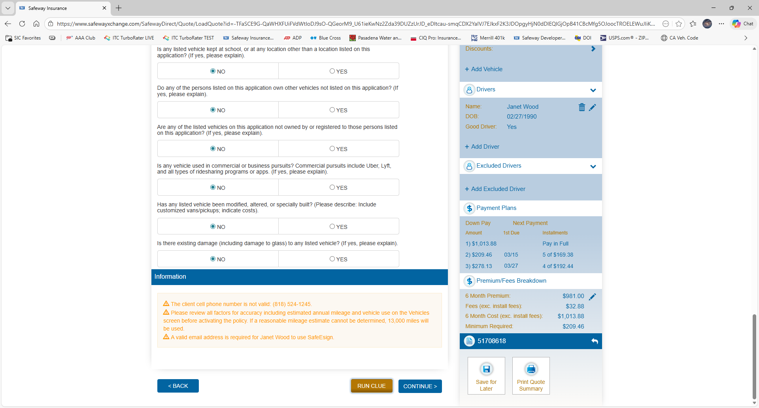
Run Clue to continue.

Slide 11
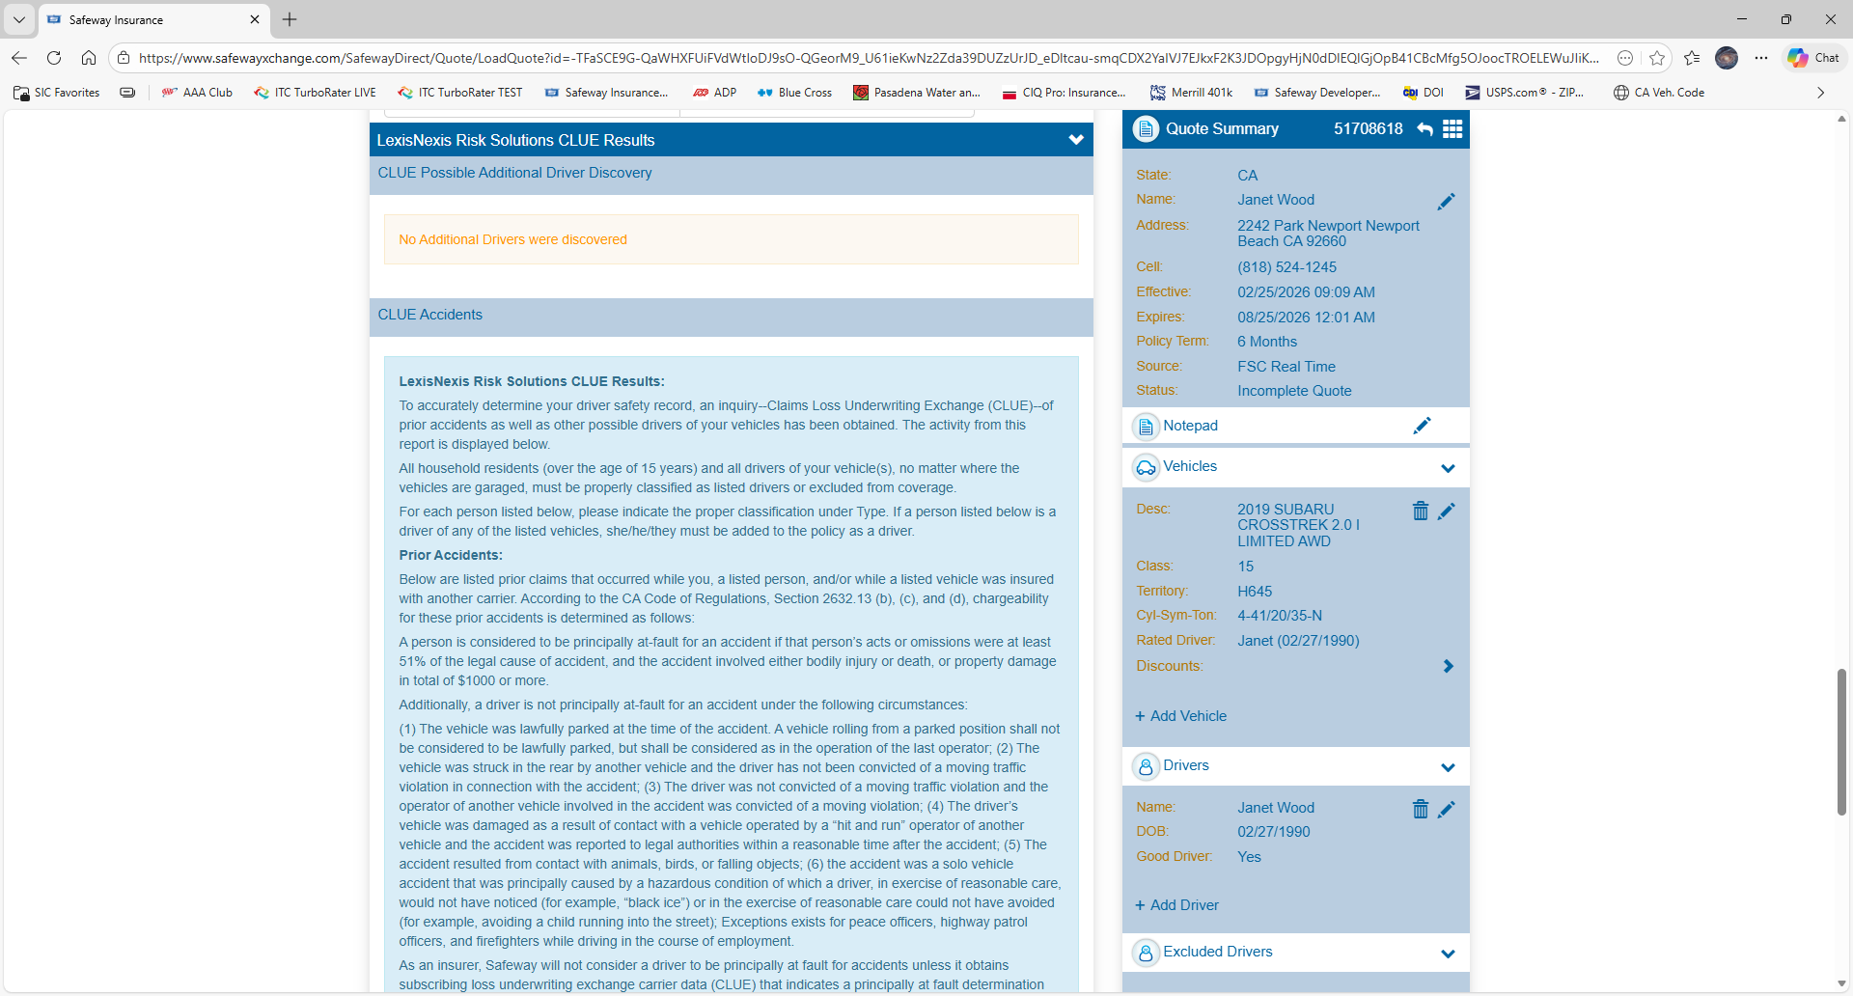
If any additional drivers are found, they will be listed here and defaulted as Excluded.
There are additional descriptions that can be selected to describe the status of the individual found on CLUE.

Slide 12
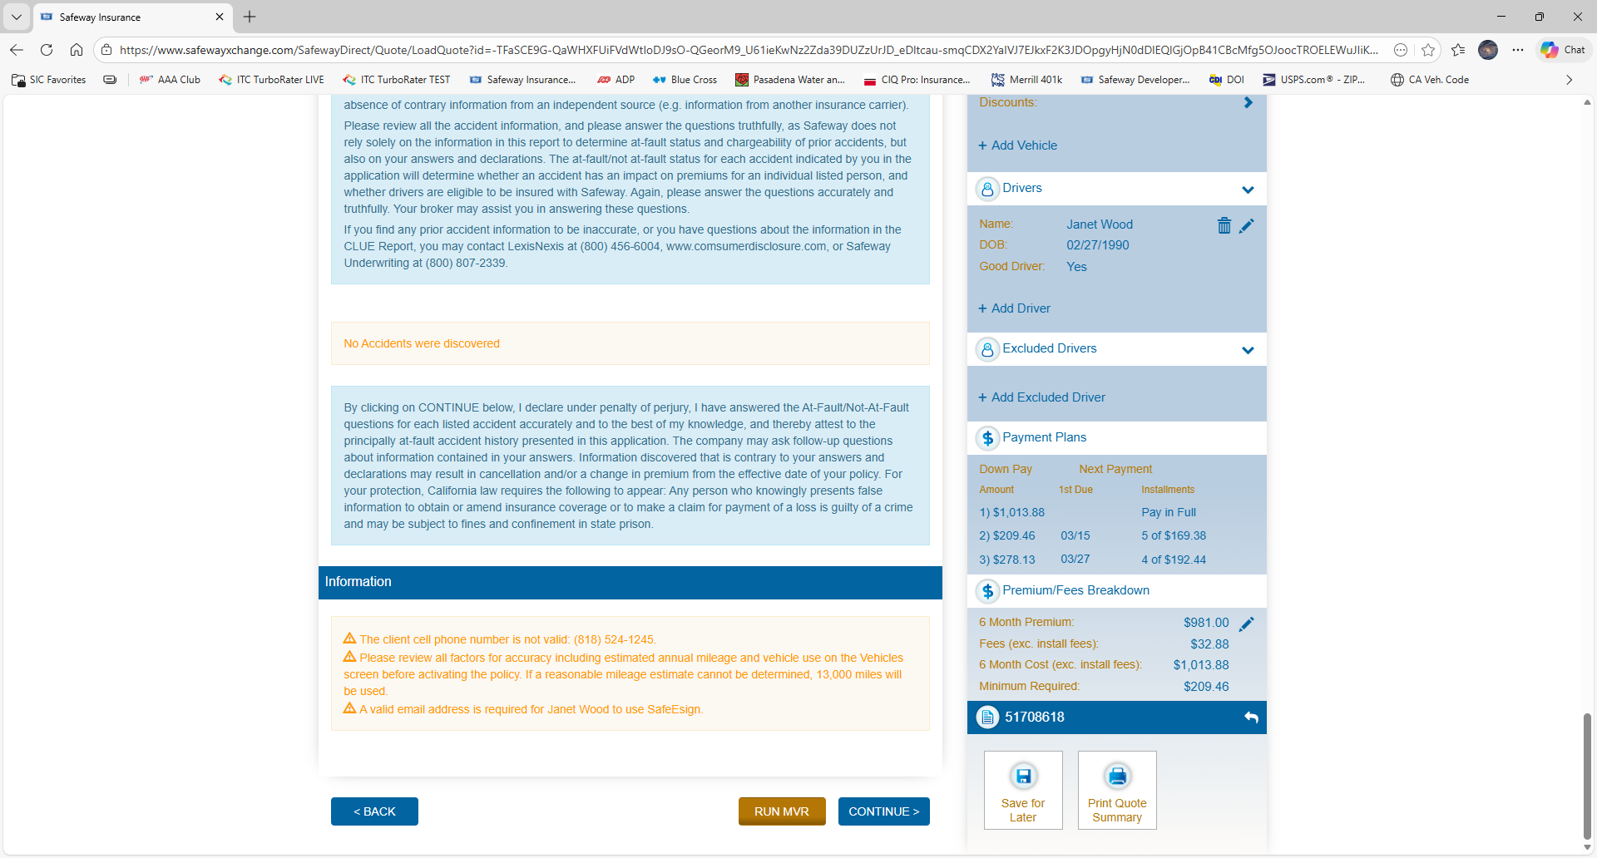
Any accidents found will be listed here.
Run MVR to continue.

Slide 13
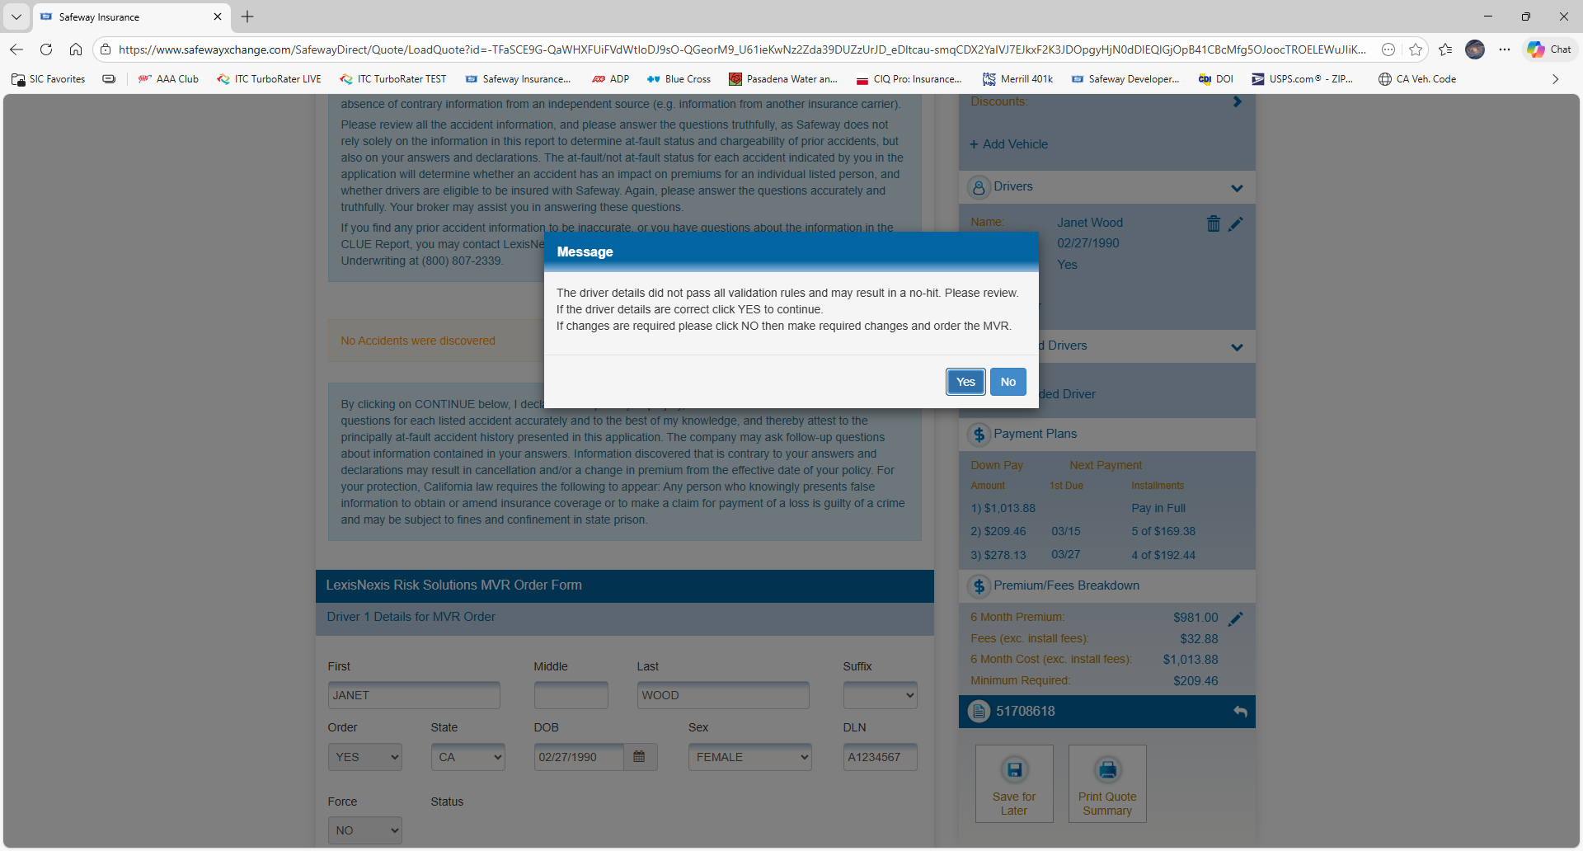
If the insureds name is slightly off or the last name is combined with the maiden name, this message will appear.
Please select Yes to allow the system to correct and use the information found on the MVR

Slide 14
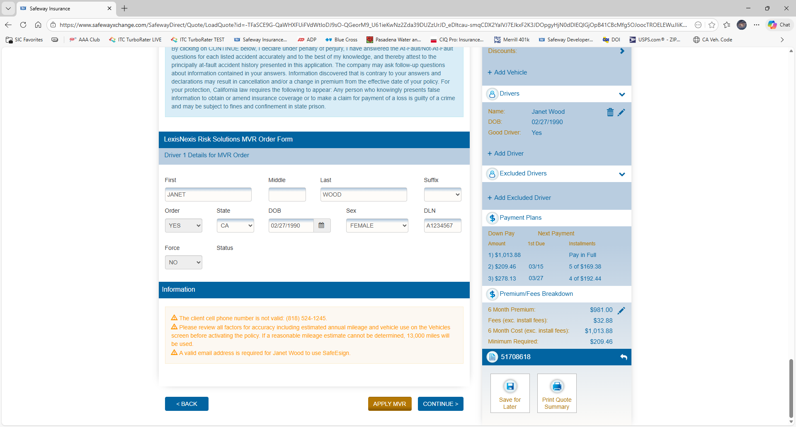
After the MVR is generated, the finding will be listed here.
Apply MVR to continue.

Slide 15
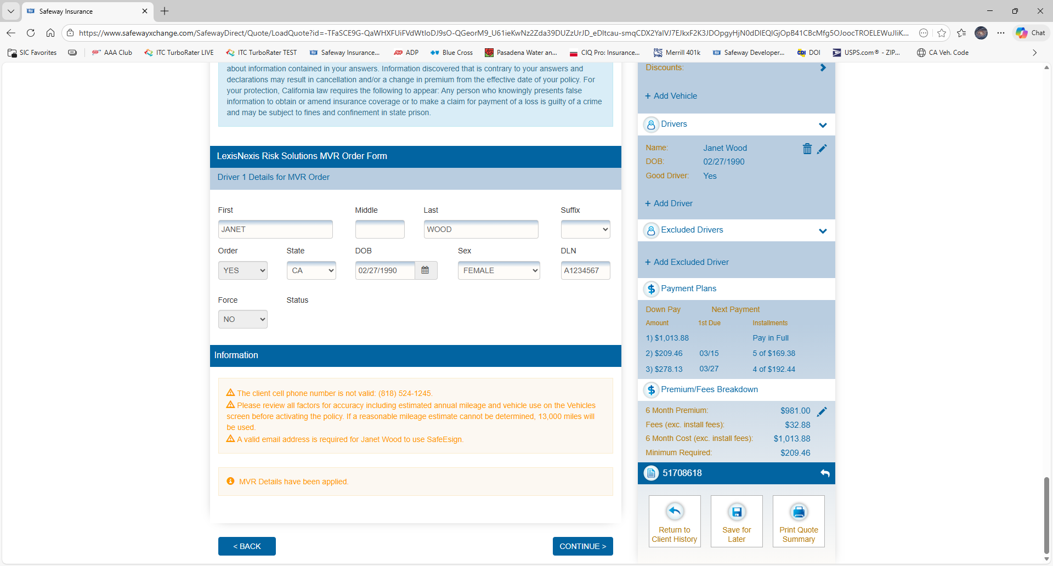
Click to continue.

Slide 16
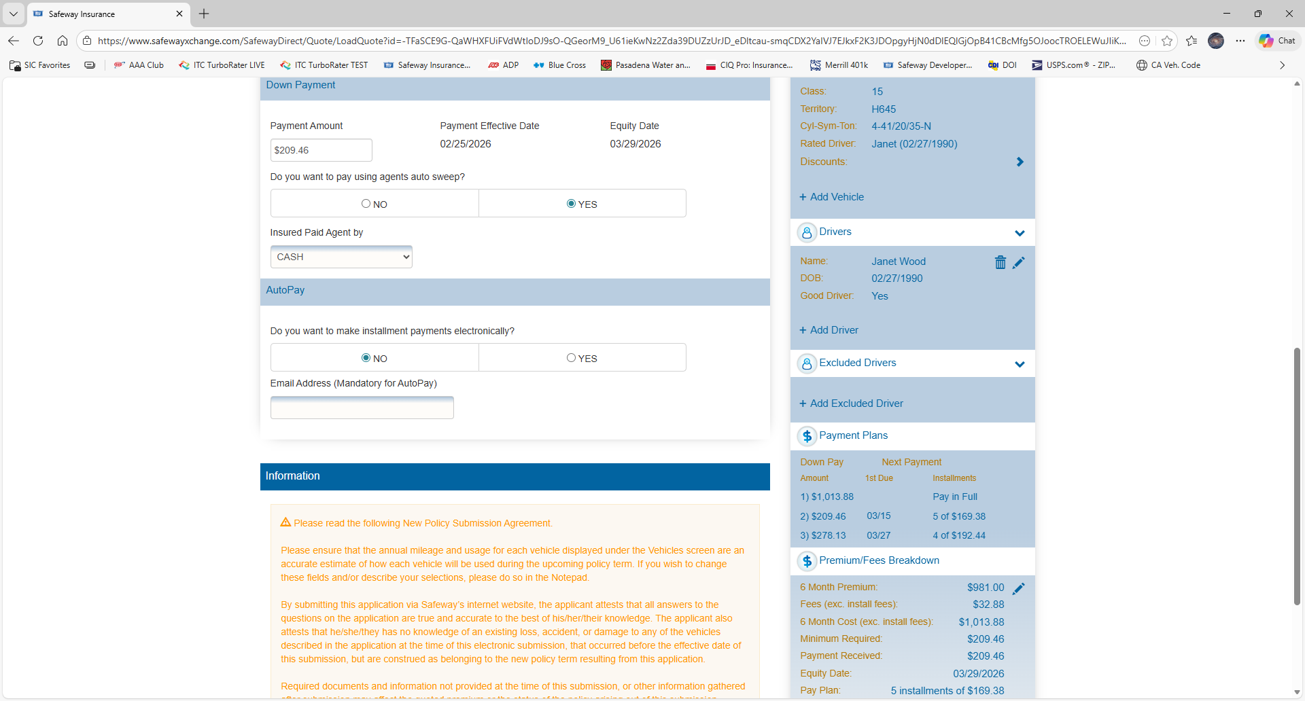
Select Yes for the Agents Auto Sweep and select Cash for insured paid agent by.
Provide an email address and select Yes if the insured wishes to make installment payments electronically.

Slide 17
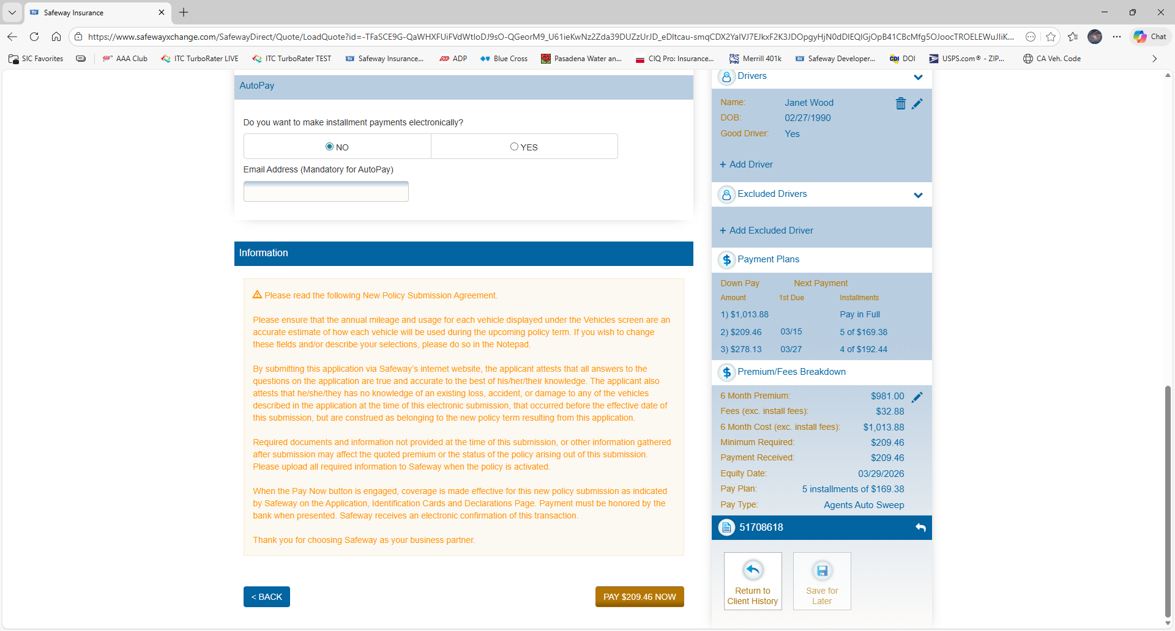
Click Pay Now to activate the policy.

Slide 18
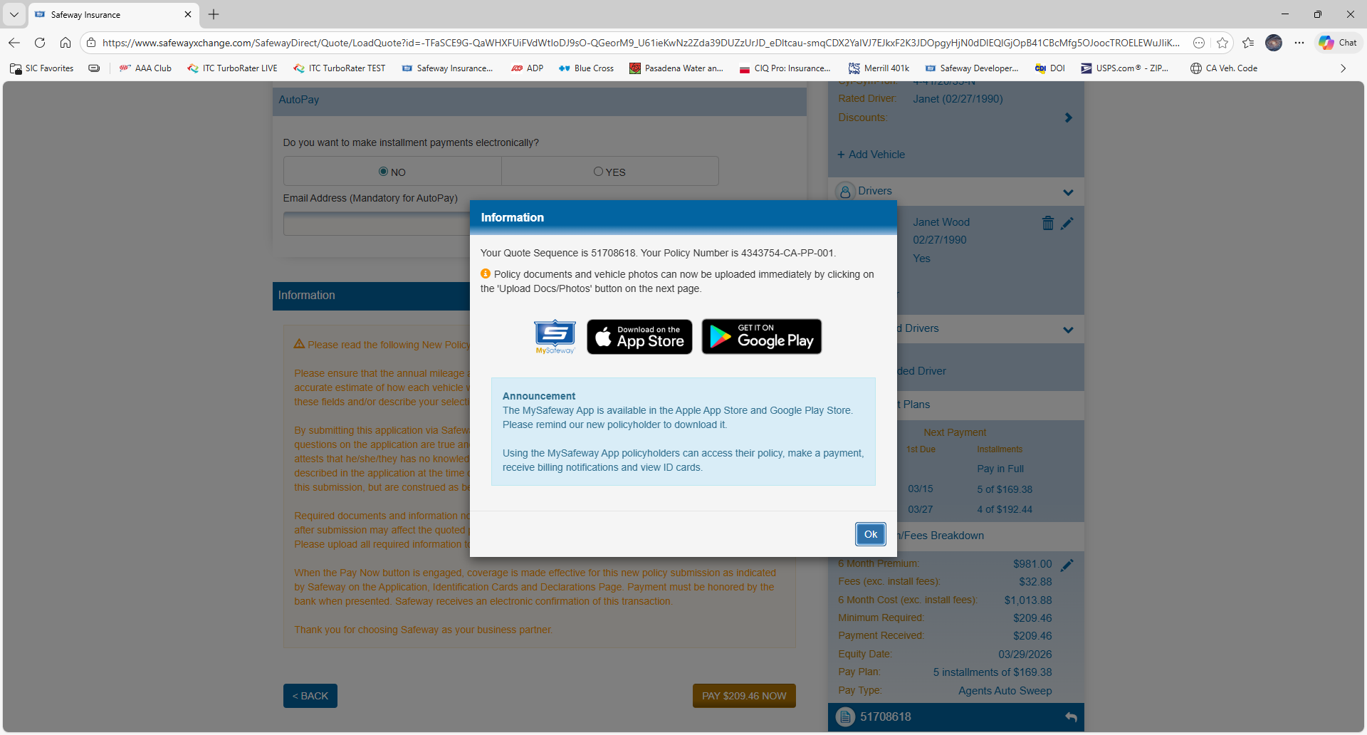
Please take a moment to recommend our MySafeway App.
The insured will be able to make payments and view their ID cards.
The app also has a camera option. The insured can take their own photos of vehicles, registrations and driver licenses. All are automatically stored in their file on our system.

Slide 19
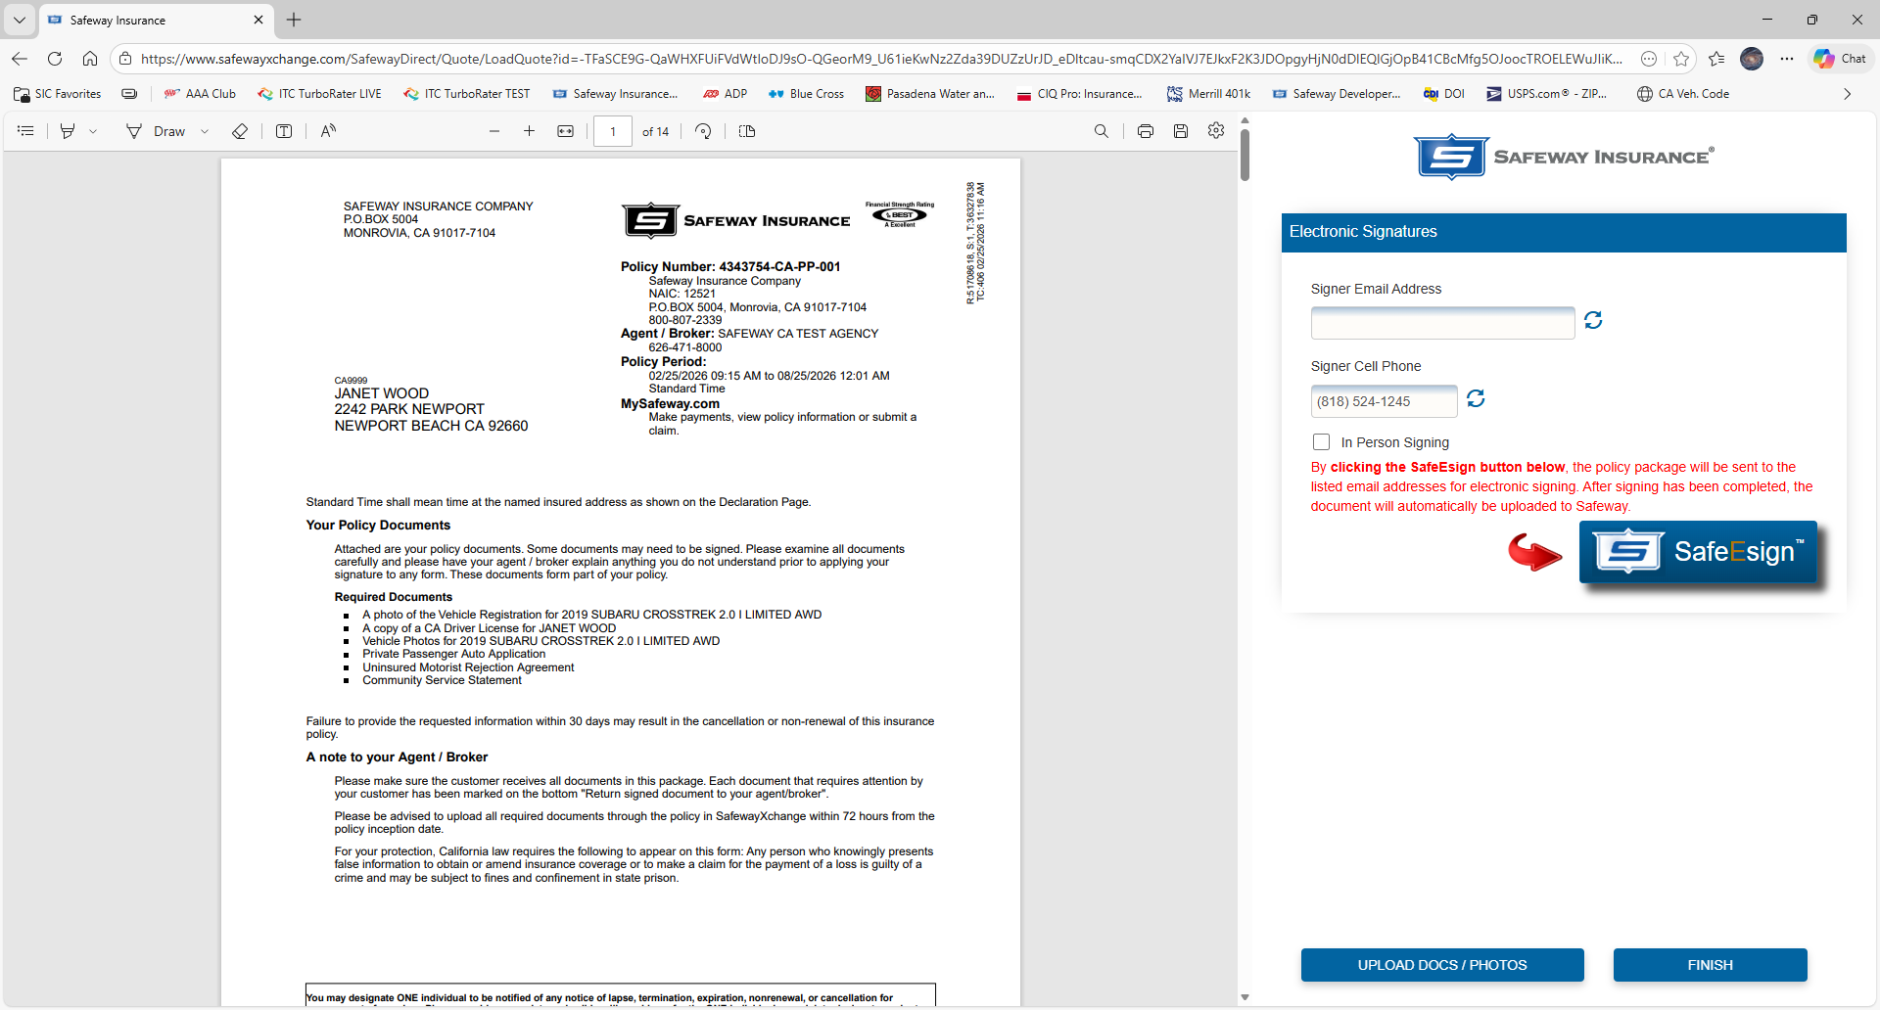
The application can be printed from here for traditional signatures
Standard Emailed E-Signature request.
In person E-Sign uses the insureds cell phone to text them a 6-digit code. Enter the code in the box that appears and click SafeEsign.

Slide 20
Thank You
If you have any questions, please contact your Marketing Representative or our Underwriting Department at 626-471-8000.

