Slide 1
Underwriting: Motorcycle
National General

Slide 2
Steps to UW policy
1. To UW policy there is no need to print application
2. Log info general information In loopitas - if policy was a split that means that office agent and commercial agent process the policy together
3. Open attached documents (signed policy & supporting documents) & also log in into national gen open policy
4. Check that application and internals reflect the same thing that we have online
5. Nothing must be corrected or missing then
6. If something needs to be corrected, log in as suspense in loopitas, email agent and manager and log it as suspense (Slide 5)
7. lasty, log by saying that UW has been process (slide 24)
Since Commercial at point of sale submits application, there is to need to upload application, unless specified by company check slide 8.
(And your done with process)

Slide 3
Documents needed to underwrite, this policy does not need to printed and uploaded to company, we save in lae
Receipt
Application
Internals
Copy of insureds driver's license
Registration, sales contract and or title
Insured statement

Slide 4
factors when underwriting a motorcycle application
3- Application
Insureds full name must match to DL
Address must have correct spelling and match insured statement
Insured & driver's name, birthdate, and DL# must match DL
Check added & excluded drivers (signed exclusion must be on file)
Vehicle information must be the same as registration & info given on insured statement
Check that coverage, is what the insured requested on insured statement
Insured MUST be the owner on the reg, if not exclude registered owner & 30-day statement must be obtained
Verify Initial payment confirmation (receipt- NB IPP)
Insured and agent/ broker Signatures, initials and dates on application
Verify and upload information requested on the "TO DO"
1- Receipt: concepts in this format
Broker fee -
BF commercial -
BF Marketing -
Donation -
VR (Veh Report) when applicable
NB IPP (payment to company)
2- Insured's Statement
Walk-in, client. This form is given to insured by agent
insured MUST to manually fill out
Once filled out, insured is to sign and date at the bottom of the form
*with this form allowed agent to identify insureds needs
*If motorcycle is High Performance, drivers must have an M1 on DL
4- Internals
Insureds Spelling must be as showed on DL and match to Application
Verbal disclosure must match vehicle and coverage to application
Excluded drivers on application must match driver exclusion disclosure
BF agreement: Check insured spelling, initials and both insured and agent signatures. BF needs to match receipt (sum of BF, BFC, BF MK and DONATION)
Signatures from both Broker and insured MUST be on all internal forms.
Loopitas:
Enter information
Select NB- Comm
Receipt #
Cust ID
Policy Sales Date
BF: Office agent
BF Comm: Rancho agent
Office
Comp Name: Nat Gen
Policy Type: Motorcycle
Policy #
Premium: You will find this on app (Combined Veh Premium- no include fees)
5- Supporting documents
Insureds Driver's license *check if drivers has an M1
Registration/Title
Additional driver's license

Slide 5
Agent sold
Receipt number
LAE ID number
Agent name
Date sold
Office agent BF
Commercial Agent BF
To which office does agent belong to
Select: National General
Select: Motorcycle
Obtain this from application or LAE
Obtain from Application
Combines Vehicle Premium
KEY POINT
If policy was sold by
Two agents (split), each agent needs to be registered in Loopitas separately
Office agent = broker fee
Corporate agent = broker fee commercial
ANY ERRORS MUST BE SUBMITTED HERE-

Slide 6
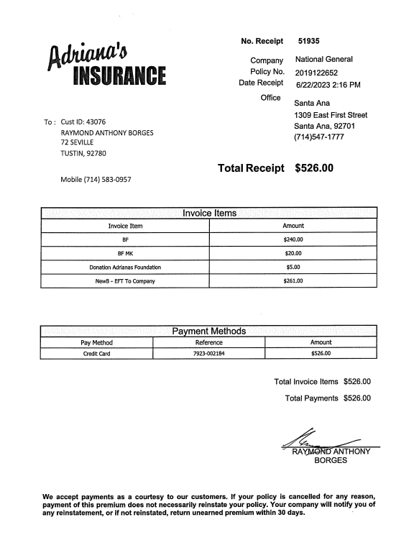
Receipt
Insured Info:
Full Name
Mailing address
Mobile number
Cust ID 23231
John Smith
123 N New Ave
Rancho Cucamonga CA 90912
909-291-1234
CO: must match to all internals and app
Policy Num
Receipt Date: is the date the app gets generated
Receipts Concepts:
BF by phone
BF Commercial
BF MK
Donation
NewB-EFT to company
Amount charged
Payment Method: payment can be applied CC, Debit, or cash
REQUIRES Insured Signature

Slide 7
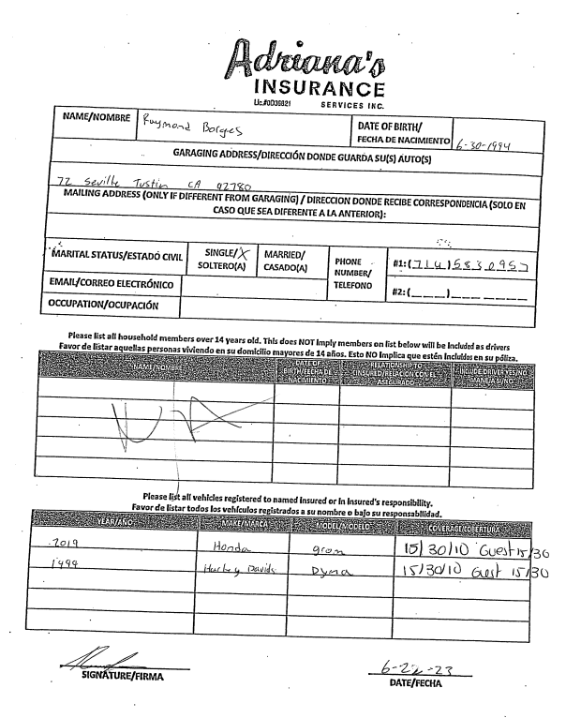
key points
M1 license (motorcycle lic) is required for comp/ Coll and to insured a high performance motorcycle
If the reg is not under insureds name, we allow 30 days for insured to register cycle & reg owner must be excluded
Keep Application on file, Any information that company require will be shown on the agency "to do" list. If anything is required you need to Log in into company's website and upload
Insureds Birthdate
Insured's full name (obtain from DL
John Smith
1/1/1999
123 N. New Ave Rancho Cucamonga CA 90912
Mailing address
Garaging address
909-291-1234
Marital Status
If married, spouses name must be provided
Disclose any household members, if any or N/A or NONE is acceptable, blank is not acceptable
Motorcycle Info & Coverage is necessary
Example of a "High Performance"
Once insured has
Manually filled out form, signature is required
Date

Slide 8
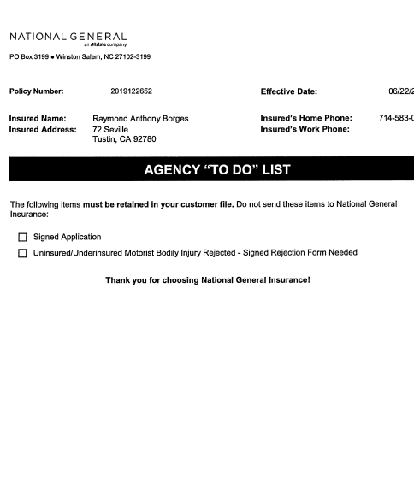
APPLICATION: Agency "To Do" List
JOHN SMAITH
123 N New
Rancho Cucamonga
cover page to the application and will add any pending or additional information that’s needed in order to keep policy active
Example:
Excluded drivers
Uninsured motorist form
Driver's License
If, these documents are requested by company, upload directly to website

Slide 9
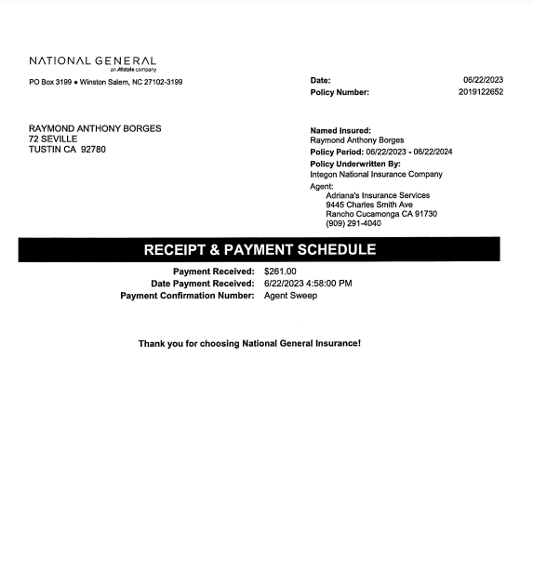
Agency sweep
JOHN SMAITH
123 N New
Rancho Cucamonga
Amount applied as agency sweep,
Must be what insured paid to initiate policy. This can be partial payment of full payment

Slide 10
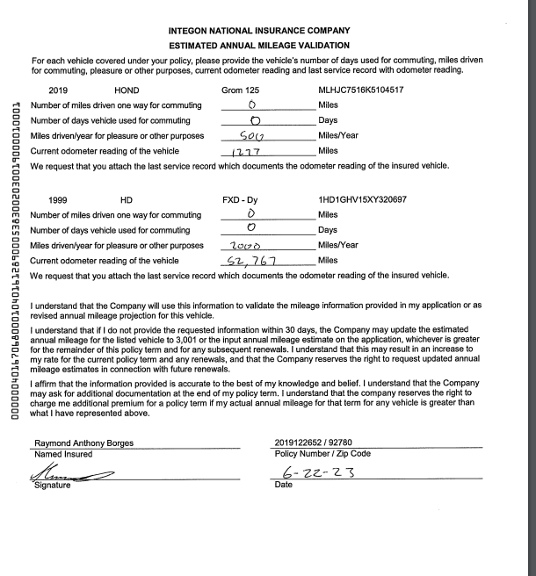
Estimated annual mileage validation form Must be filled out, signed and dated
This section requires insureds signature, and dated.
Jhn Smith

Slide 11
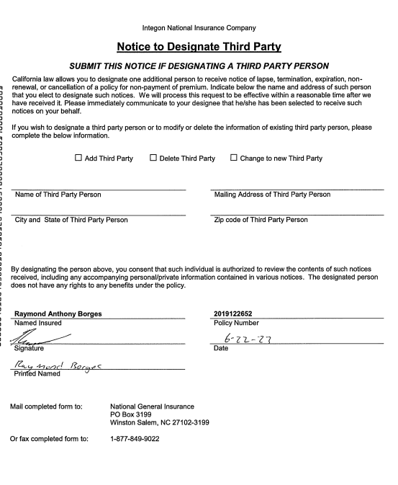
THIRD PARTY form needs INSURED SIGNATURES AND DATE, if desired list a third person to be notified on policy notices
JOHN SMITH
John Smith
Insureds signature
Print name
date

Slide 12
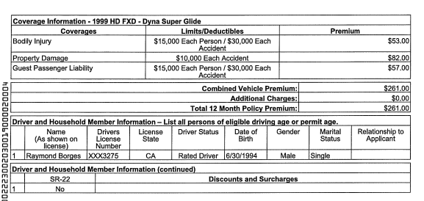
COVEragE'S
STANDAR MOTOCYCLE COVERAGE:
BODILY INJURY
PROPERTY DAMAGE
GUEST PASSENGER LIABILITY – PER ACCIDENT (it will be automatically added per company)
JOHN SMITH
Questions above are asked to the insured by the agent when quoting, verify that all have been answered with a Yor N
Drivers and Household members info: is the section where you will find listed all active and excluded drivers on policy
Total Premium

Slide 13
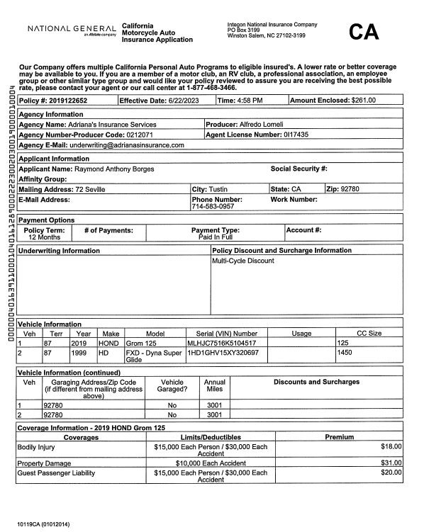
KEY POINTS TO VERIFY APPLICATION process
Company Name: Program is right next to it
Effective Date: is the Day when policy will bind
Amount Enclosed: Is
how much did insured paid
Policy Number
123456
John Smith
Applicants Info. No social security required
123 N New Ave
ABC123DEF456
123ABD123LMP
This Section is extremely important to double check:
Refence VIN #, year & model with registration or Verbal disclosure given
Confirm that coverage match with internals

Slide 14
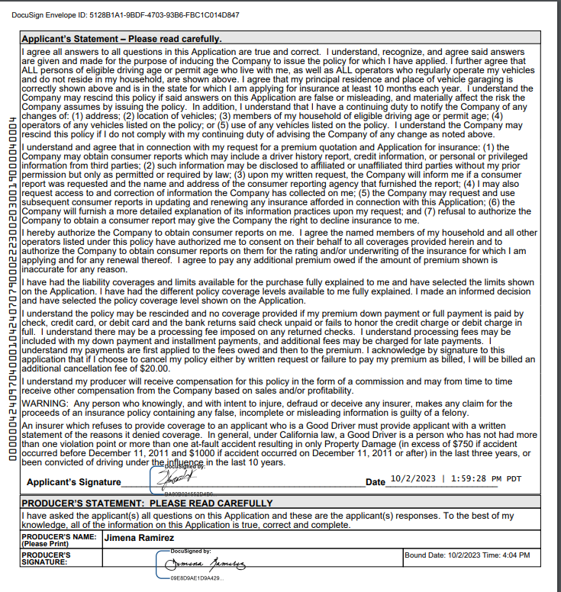
Applicants statement form—IS THE MOST IMPORTANT FORM in the APPLICATION process
Applicant (insured) must read and sign as they are acknowledging info is true
Producer must also sign and date (as witness)
Avoid any fraudulent INFORMATION

Slide 15
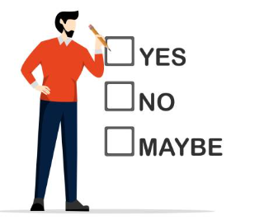
UNINSURED MOTORIST: WEATHER APPLICANT ACCEPTS OR REJECTS COVERAGE?
INSUREDS SIGNATURE IS REQUIRED –
IF INSURED SELECTED COVERAGE, THIS MUST REFLECT ON APPLICATION & INTERNALS
John Smith

Slide 16
Online notes

Slide 17
Motorcycle INTERNALS

Slide 18
Now, we are on the second half of our underwriting process. time match application information, to INTERNALS *insureds name *signatures *coverages *Exclusions *effective date *SIGNATURES *INITIALS *BROKER FEE *Also please be advised that our internals do come in Spanish *

Slide 19
VERBAL DISCLOSURE
ONCE AGENT HAS ENTER INS INFO & MOTORCYCLE INFORMATION, FORMS WILL GENERATE
JOHN SMITH
DATE
Coverages –confirm that limits are what the application has
Insured initials are needed as form of approval from statement
bottom of the page requires both agent and insured to sign
Insured to sign
Agent's signature

Slide 20
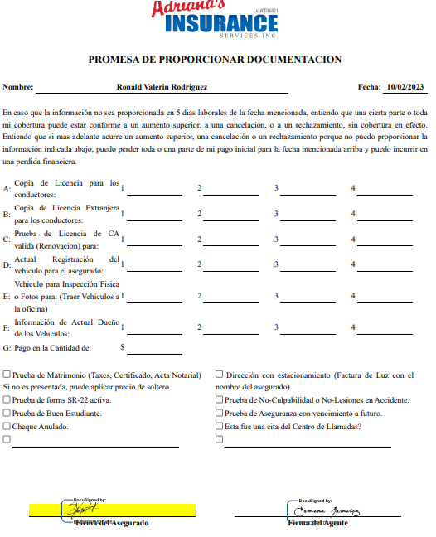
PENDING DOCS
John Smith
REGISTRATION
BALANCE DUE ($$)
DRIVERS LICENSE
PREVIOUS INSURANCE
LIEN HOLDER INFO
This section requires insureds signature and dated.

Slide 21
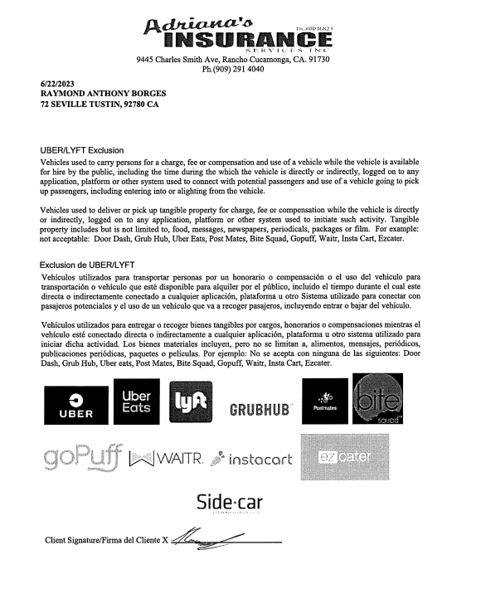
UBER/LIFT FORM
FORM REQUIRES SIGNATURE FROM INSURED

Slide 22
The Agent advised form is, a form that is provided to insured providing different unformal quotes with different coverages and rates
Client selects what work best for them and signed what option is best
John Smith
Coverage accepted
Coverage rejected
Once insured has made his selection, his signature will be required, as well as agents

Slide 23
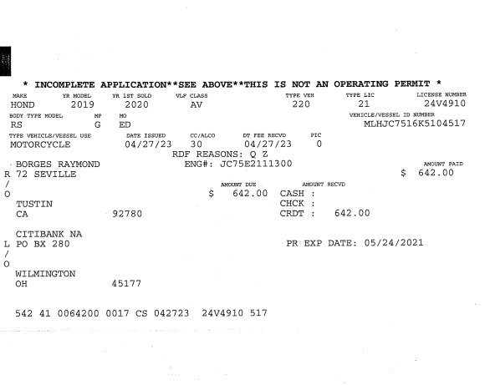
SUPPORTING DOCUMENTS
DRIVERS LICENSE:
Driver does not have an M1, therefore experience should answer with "zero"
ABC123DEF456
John Smith
123 N New Ave
Rancho Cucamonga CA 90912
FSM1234
SMITH
JOHN
01/01/1999
Issue date

Slide 24
BF Agreement THIS IS THE CONTRACT BETWEEN INSURED AND ADRIANAS INSURANCE Company
KEY POINTS:
Insured name must match policy and DL
Broker fee amount is the sum of BF, BFC, BF MK & DONATION (BF BD if applicable)
Form must be initialed, and signed by insured & agent
Broker Fee, is not Refundable
John Smith
Insured
initials
BF amount
Needs to
match receipt
Insureds initials

Slide 25
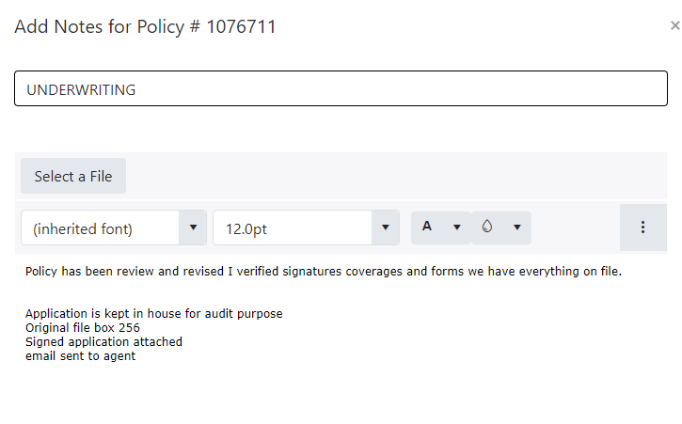
LAE & UW 22 (loopitas) PROCESS
Once verified receipt, insured statement, all initials & signatures on application & internals, and supporting documents; continue with the following steps:
add a log with the underwriting note stating what was revised and reviewed (as shows picture)
If pending information was found on the uw process it must be listed as suspense indicating what information is pending/ missing
Suspend log in lae to agent
Create and send an email to the agent with the missing info, on the email cc the manager/ regional
Print email suspense to lae
Register receipt to uw 22 (loopitas) and enter all the pending info
Save suspense in loopitas

Slide 26
Last steps: once revised, and policy is gtg, there is no need to print or upload to company
Order policy as follows to be scan: 1-Receipt 2- Insured statement 3- Application 4- Internals 5-Supporting documents
application is keep on our file unless is being requested by company, on the Agency "TO DO" list (example; Driver License, exclusion form etc.)
ATTACH APPLICATION TO LAE & LABEL "NEW COMMERCIAL POLICY"

Slide 27
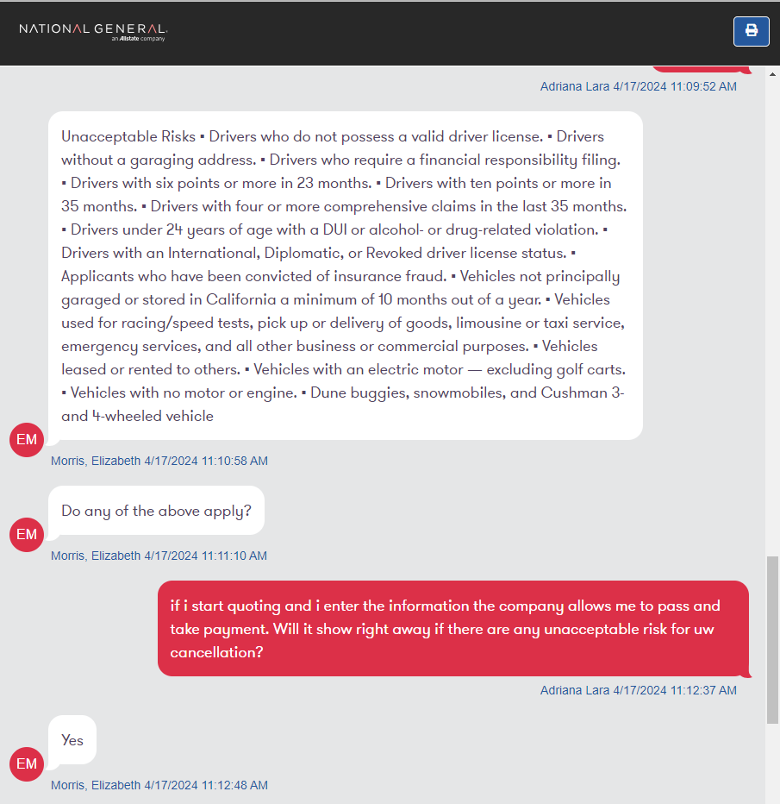
If motorcycle is salvage, no comp and coll acceptable

